Slide 1
Dark & Deep Web
Details & How to Access Them

Slide 2
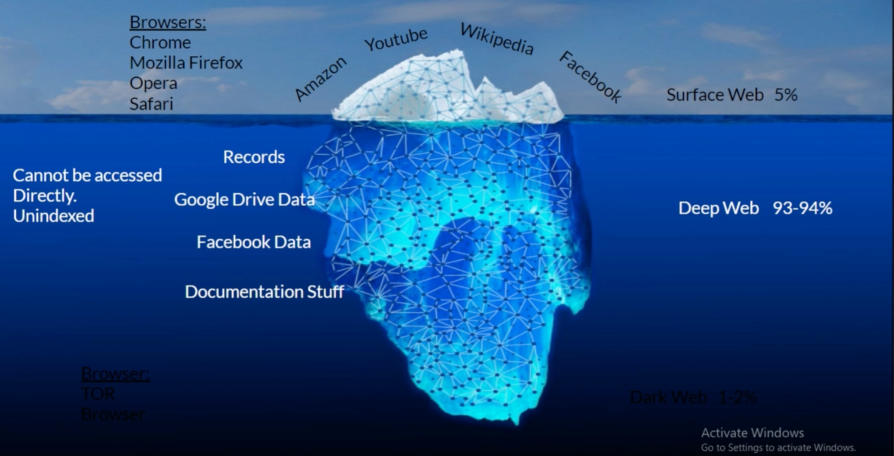
Surface, Deep & Dark Web

Slide 3
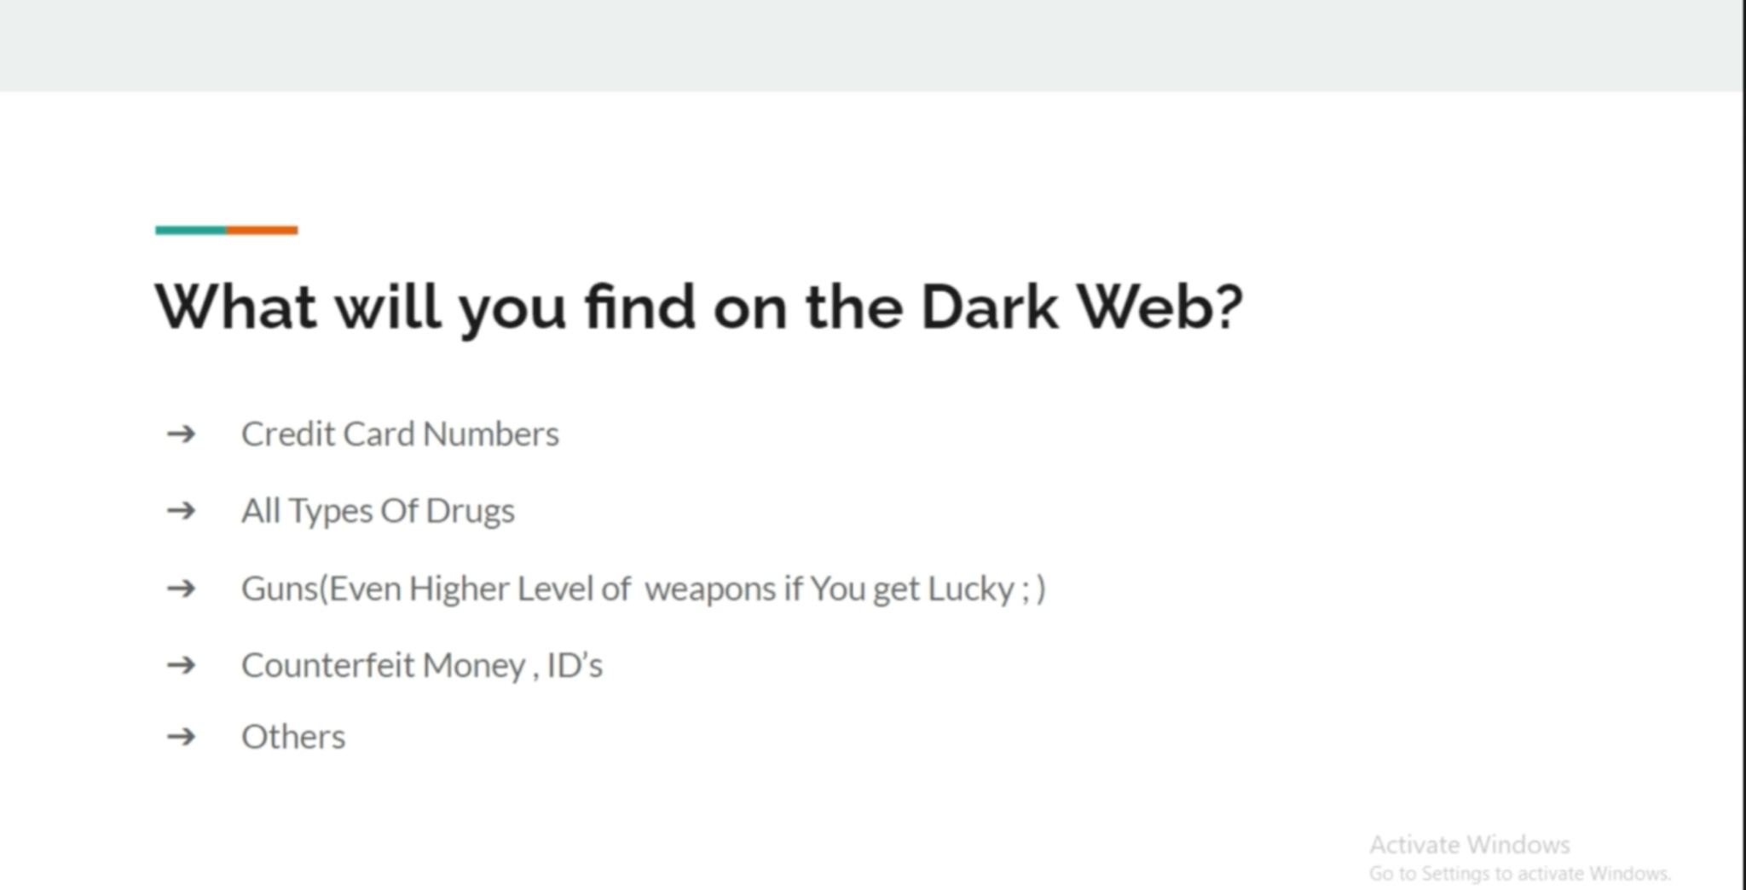

Slide 4
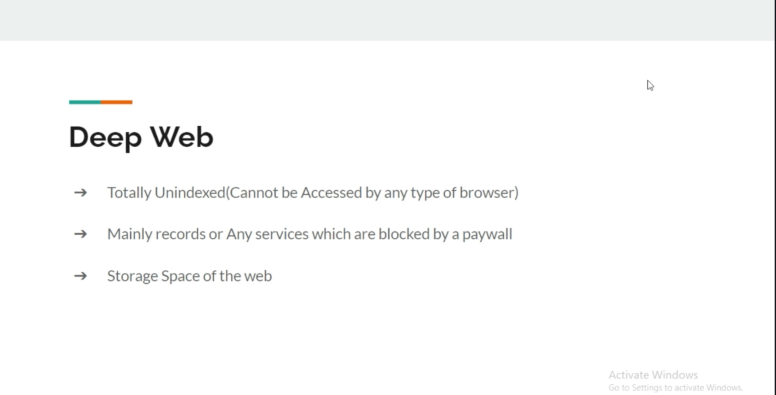

Slide 5
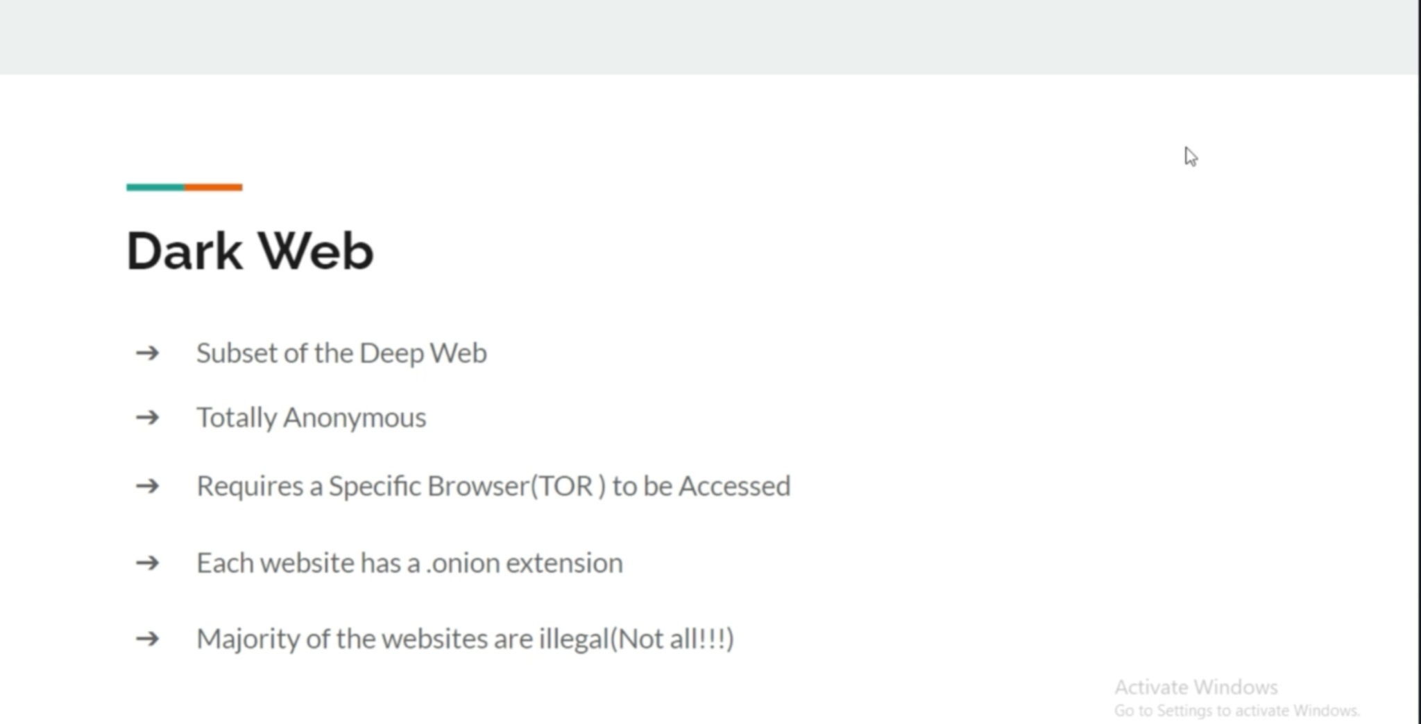

Slide 6
More To Find
Illegal drugs
Hitman
Child abuse/ sex
Cheap products like: iPhone, MacBook pro
Paypal accounts
Bank cards
dark web live
animal abuse video
hackers
raptor (links and files)
stolen data / paypal / credit card
human products
buy guns/ grenades

Slide 7
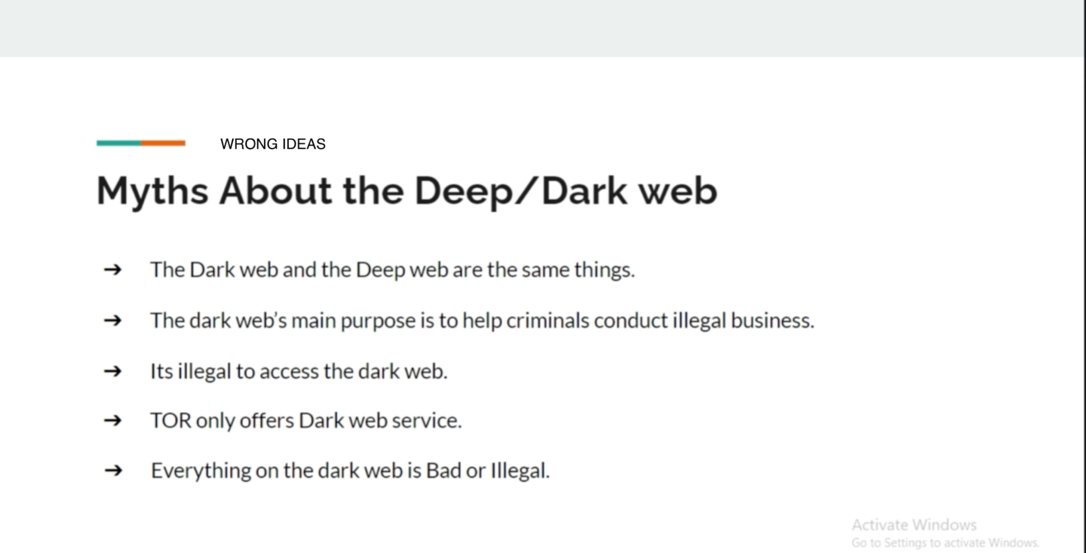

Slide 8
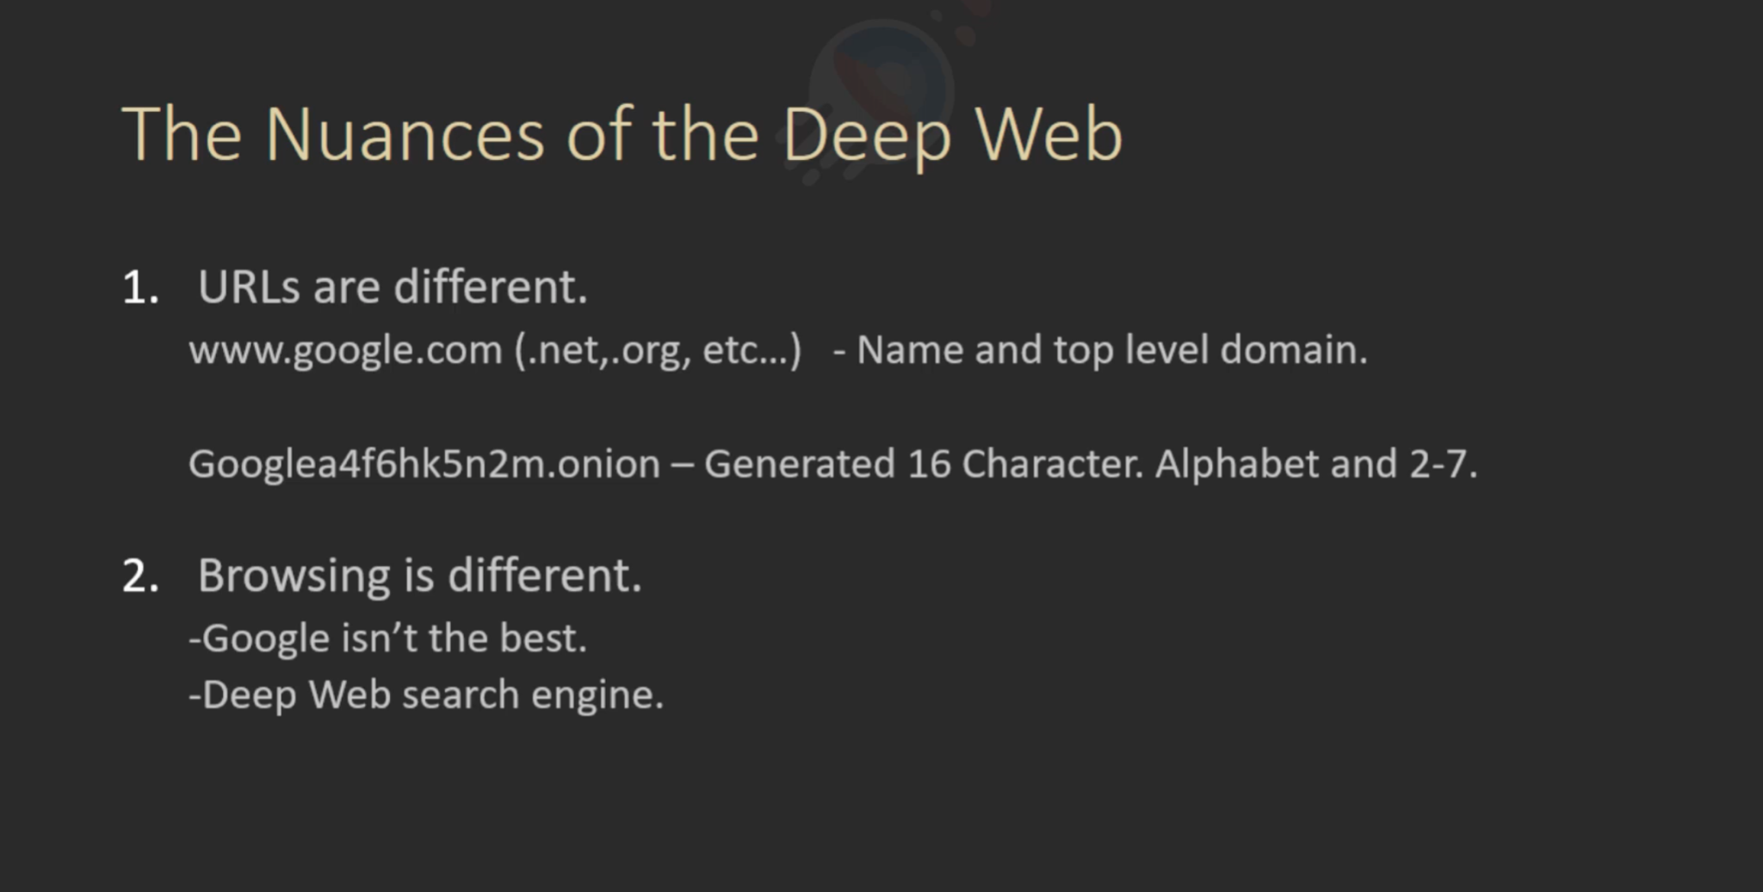

Slide 9
How the websites addresses looks like
http://nr6juudpp4as4gjg.onion/ +– Tor Girls
http://tuu66yxvrnn3of7l.onion/ – UK Guns
http://nr6juudpp4as4gjg.onion/ – Used Tor Guns
http://ybp4oezfhk24hxmb.onion/ – Hitman Network
http://qizriixqwmeq4p5b.onion/ – Tor Web Developer
http://vfqnd6mieccqyiit.onion/ – UK Passports
http://newpdsuslmzqazvr.onion/ – Peoples Drug Store
http://jv7aqstbyhd5hqki.onion/ – HackBB
http://xfnwyig7olypdq5r.onion/ – USA Citizenship
http://bitmailendavkbec.onion/ – swiss email

Slide 10
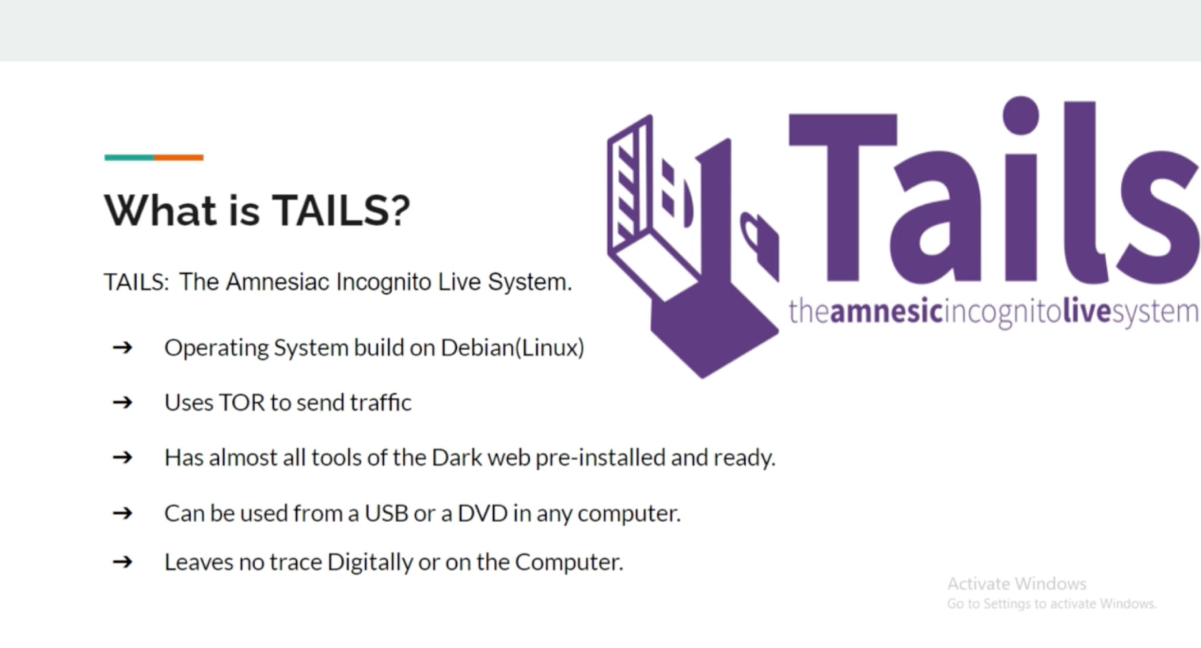

Slide 11


Slide 12
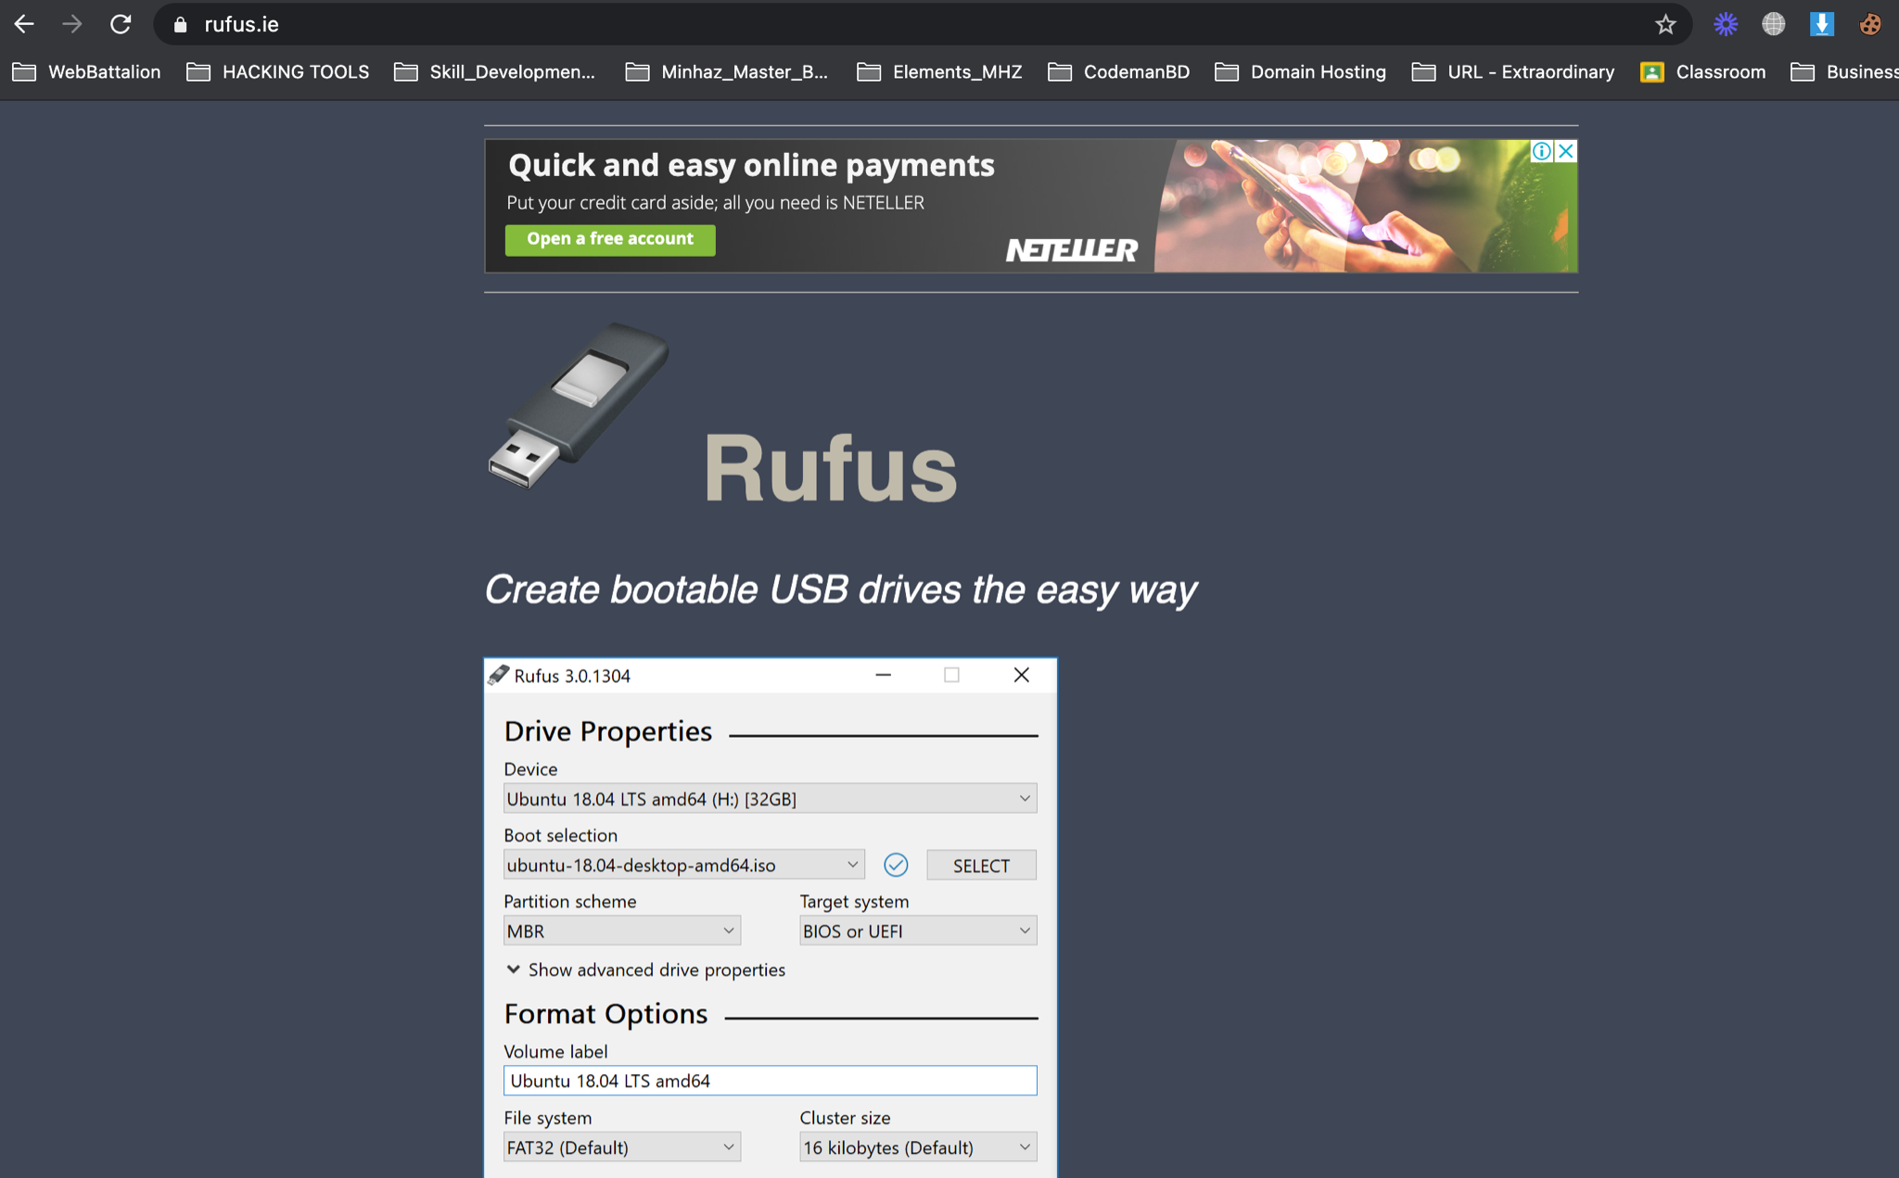

Slide 13
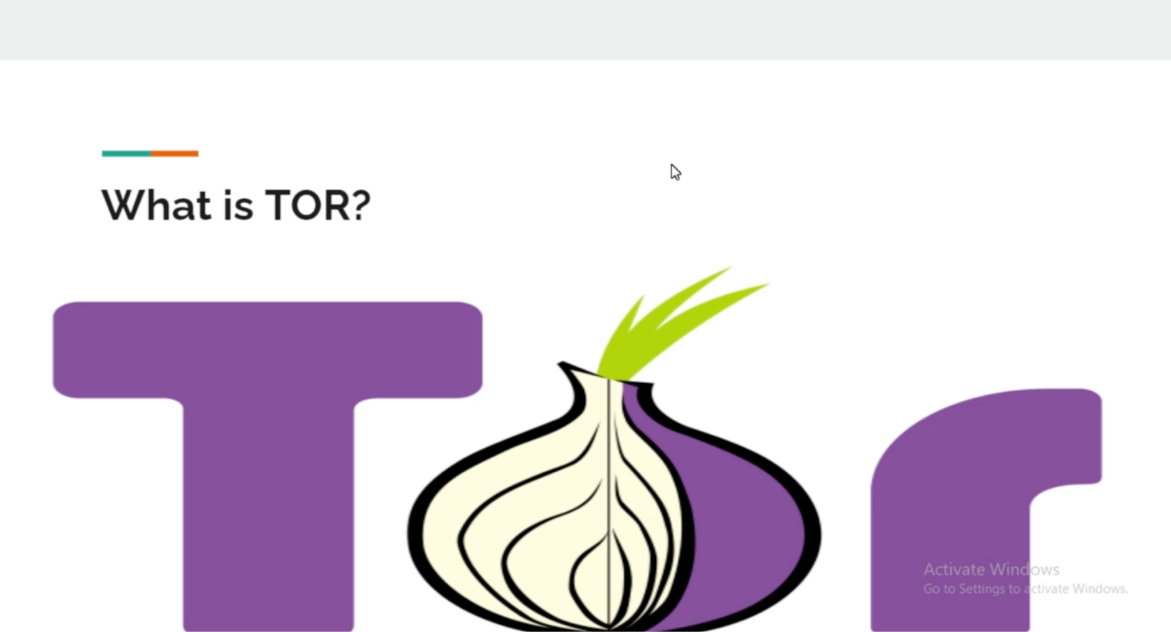

Slide 14
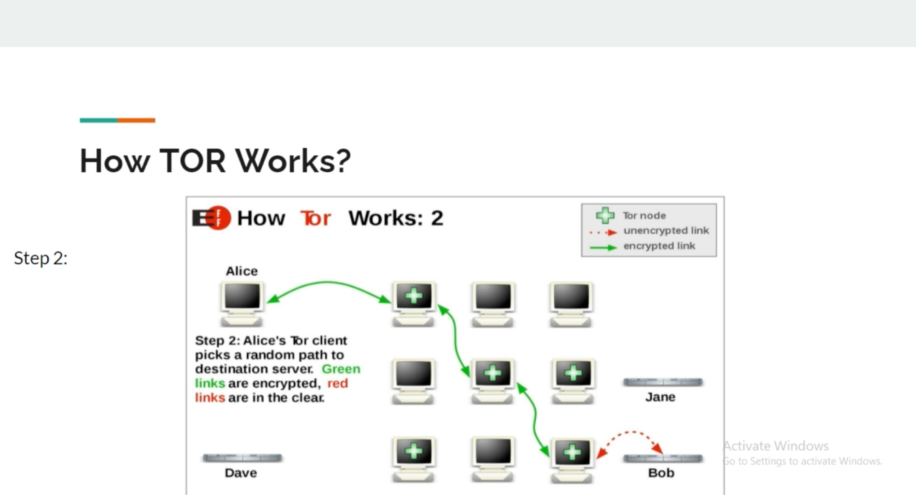

Slide 15
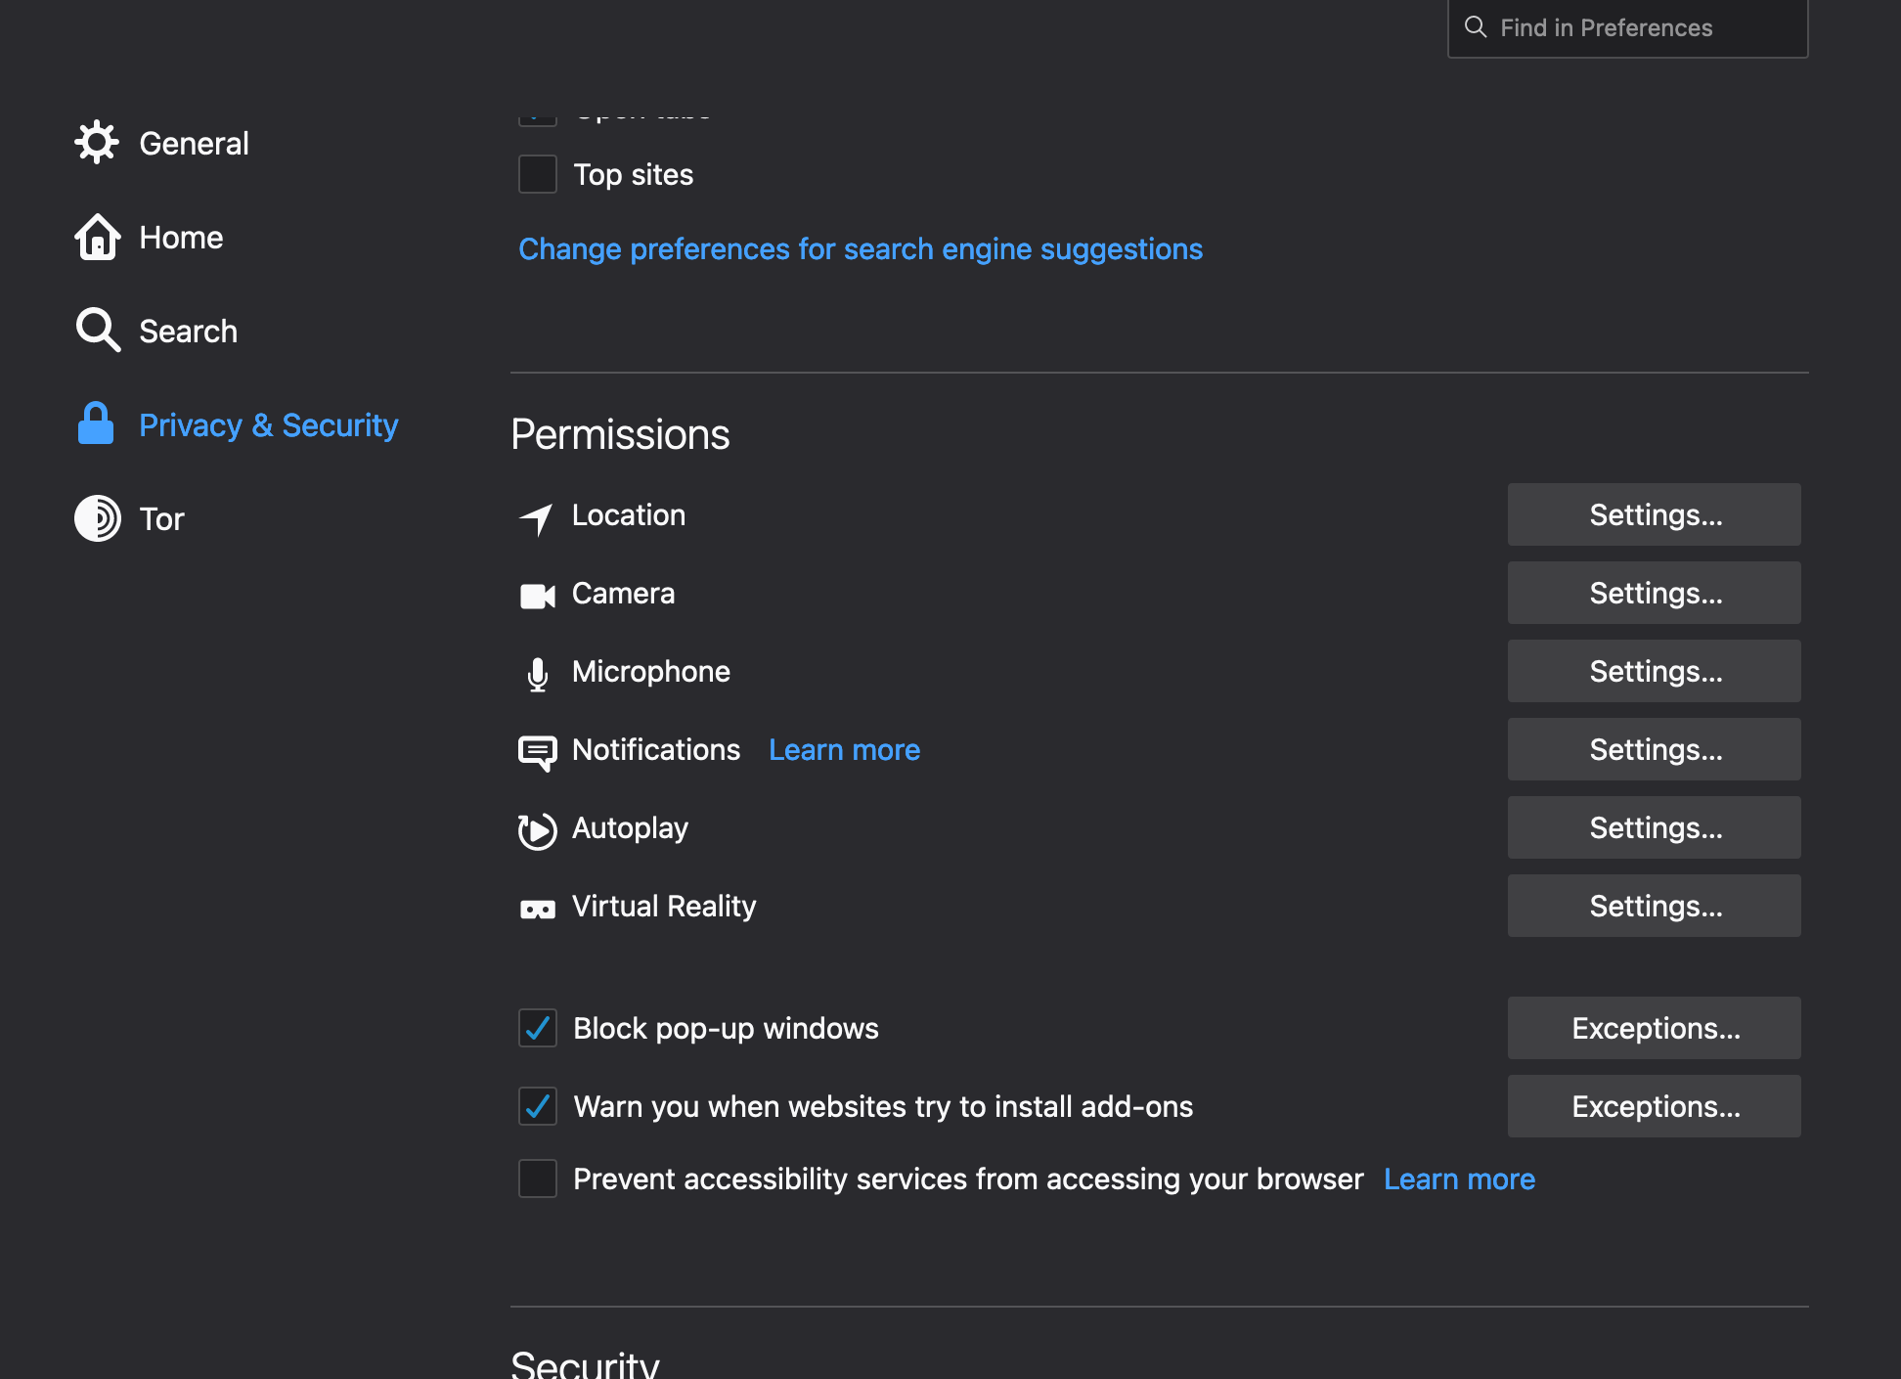

Slide 16
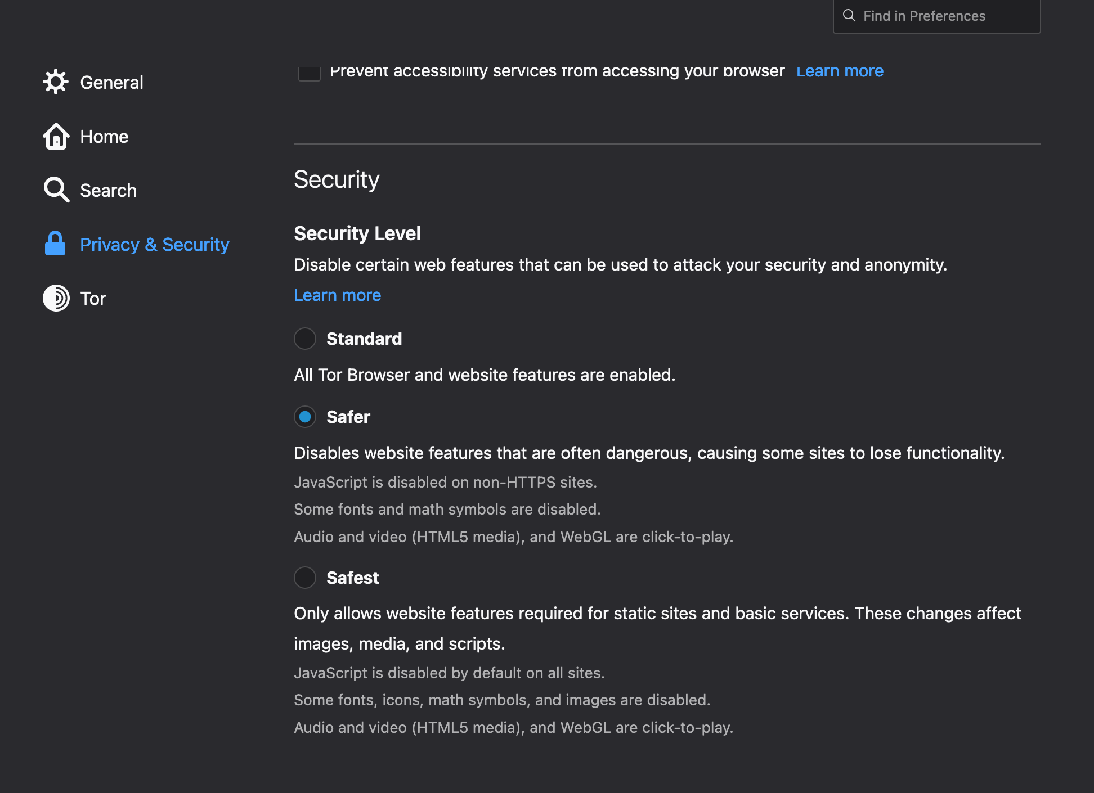

Slide 17
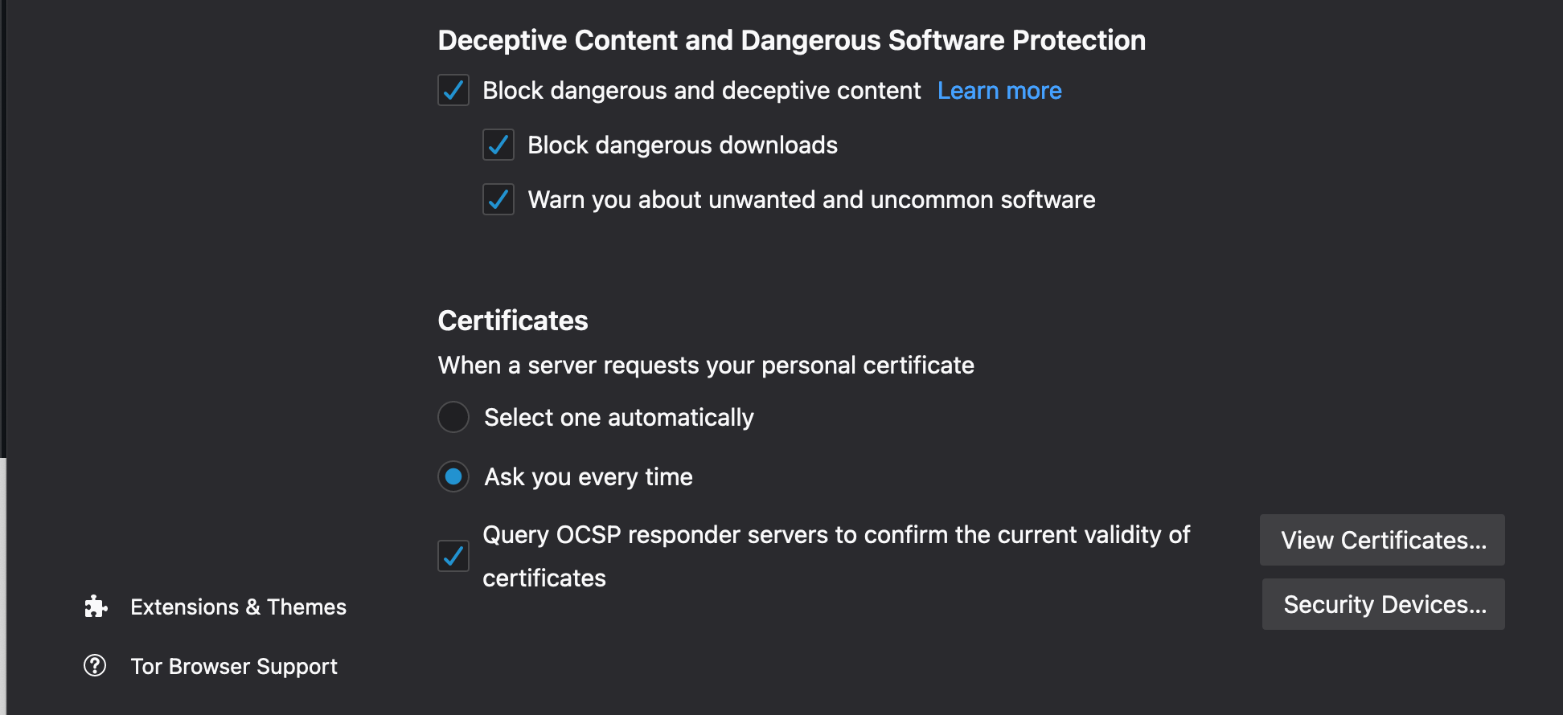

Slide 18


Slide 19
Some important search engines for dark webs
• DuckduckGO onion Link: 3g2upl4pq6kufc4m.onion
• Excavator dark web engine: 2fd6cemt4gmccflhm6imvdfvli3nf7zn6rfrwpsy7uhxrgbypvwf5fad.onion
• Grams search engine for darknet: http://grams7enqfy4nieo.onion/
• TORCH FOR FINDING DARK SITES: xmh57jrzrnw6insl.onion

Slide 20
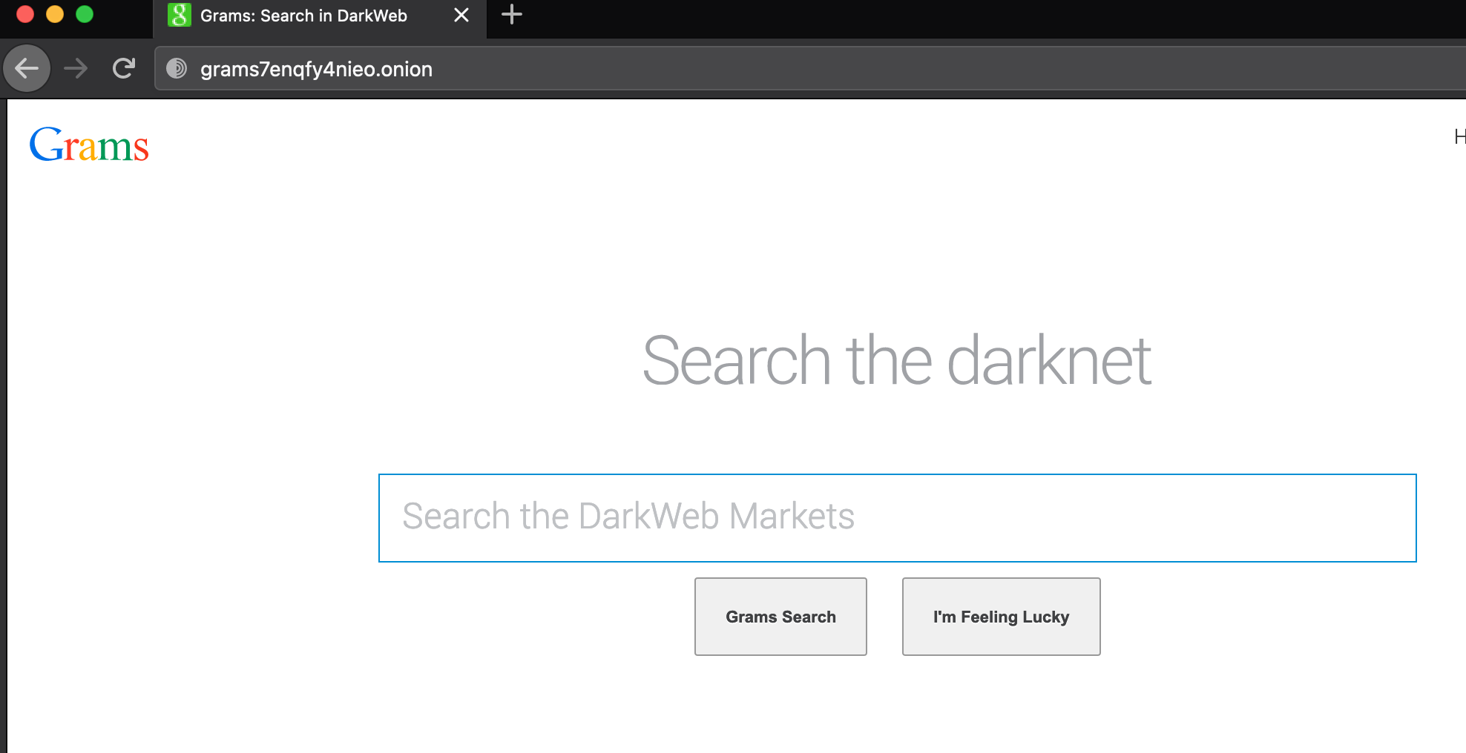

Slide 21
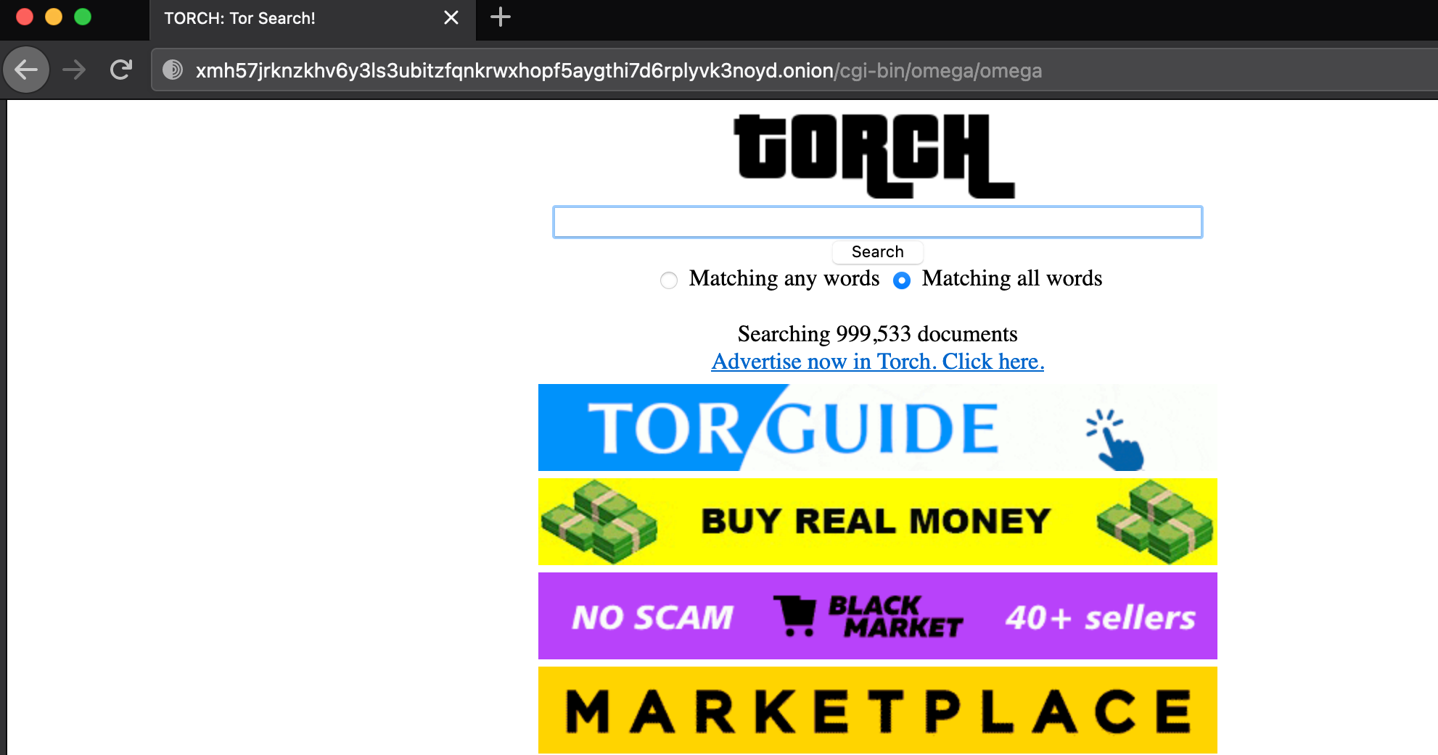

Slide 22
The Hidden Wikis
• hidden wiki: http://zqktlwiuavvvqqt4ybvgvi7tyo4hjl5xgfuvpdf6otjiycgwqbym2qad.onion/wiki/index.php/Main_Page
• The hidden Wiki(1) Onion Link: • HIDDEN WIKI (Wiki-04): http://hiddenwiki.biz/
• WIKI (Wiki-05): http://hiddenwikitor.com/
• dark Web Site links(Wiki-06) : https://onion.live/
http://s4k4ceiapwwgcm3mkb6e4diqecpo7kvdnfr5gg7sph7jjppqkvwwqtyd.onion/ – OnionLinks v3
http://6nhmgdpnyoljh5uzr5kwlatx2u3diou4ldeommfxjz3wkhalzgjqxzqd.onion/ – The Hidden Wiki
http://2jwcnprqbugvyi6ok2h2h7u26qc6j5wxm7feh3znlh2qu3h6hjld4kyd.onion/ – Another Hidden Wiki
http://jgwe5cjqdbyvudjqskaajbfibfewew4pndx52dye7ug3mt3jimmktkid.onion – Pug’s Ultimate Dark Web Guide
http://zqktlwiuavvvqqt4ybvgvi7tyo4hjl5xgfuvpdf6otjiycgwqbym2qad.onion/wiki/index.php/Main_Page – The original hidden wiki

Slide 23
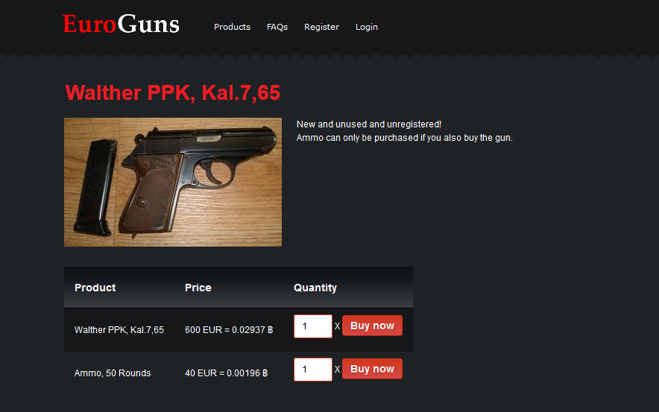

Slide 24
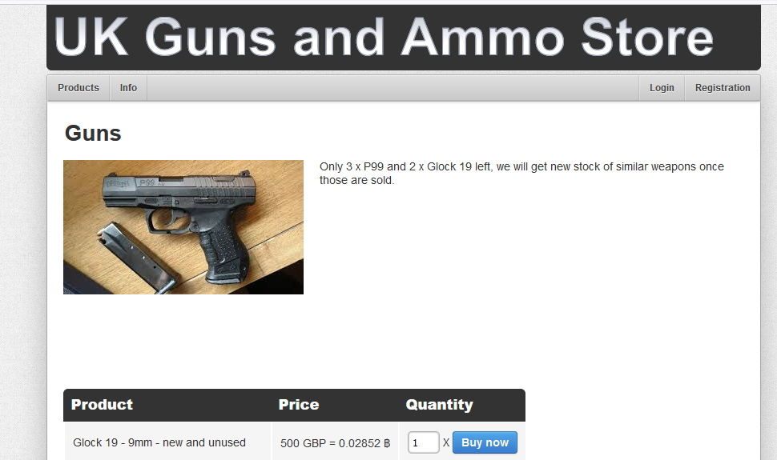

Slide 25
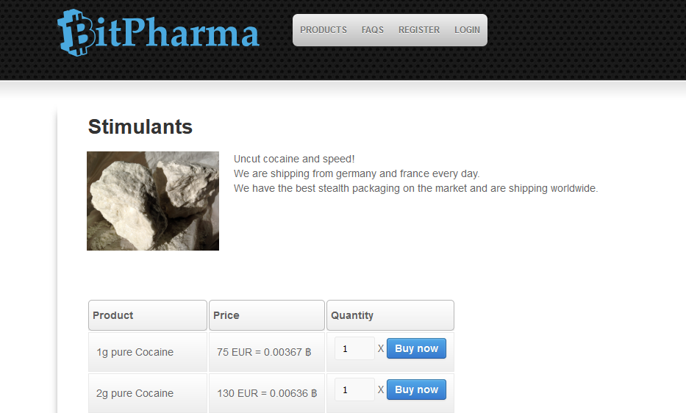

Slide 26
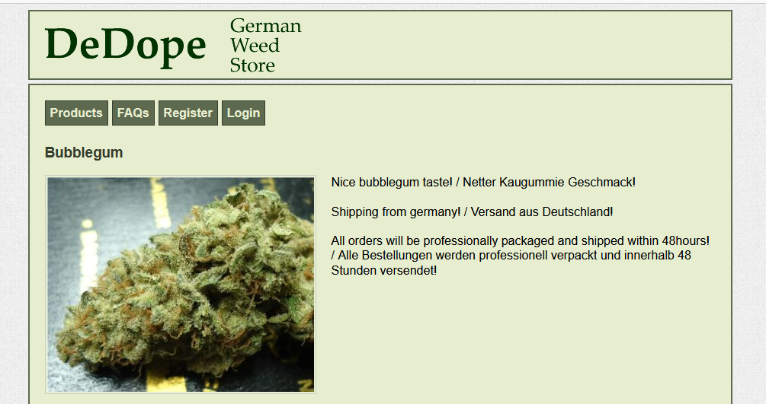

Slide 27
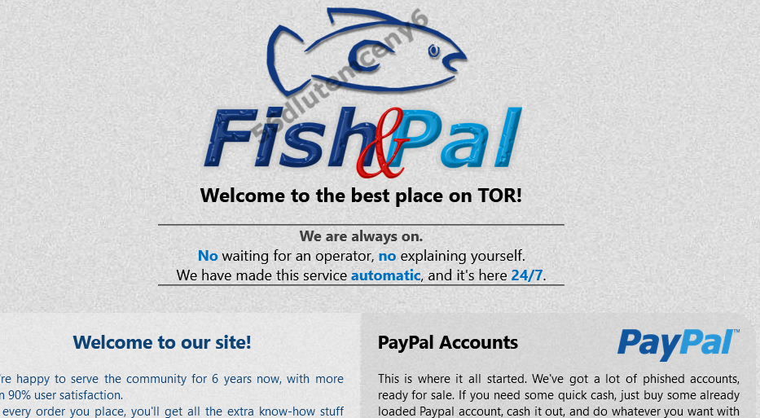

Slide 28
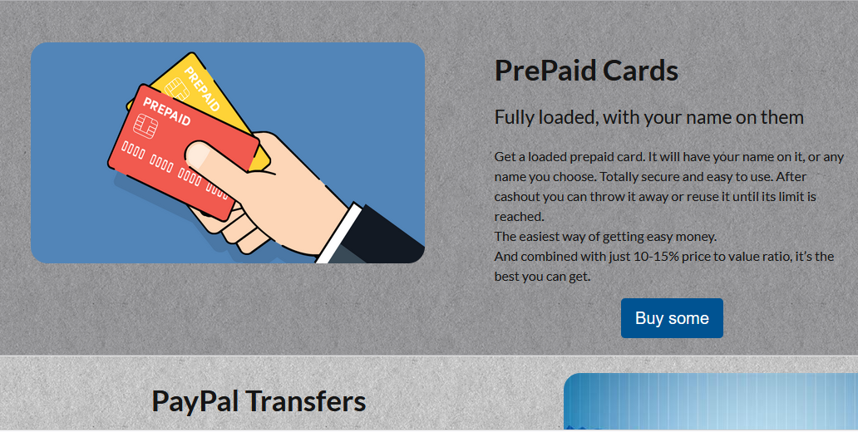

Slide 29
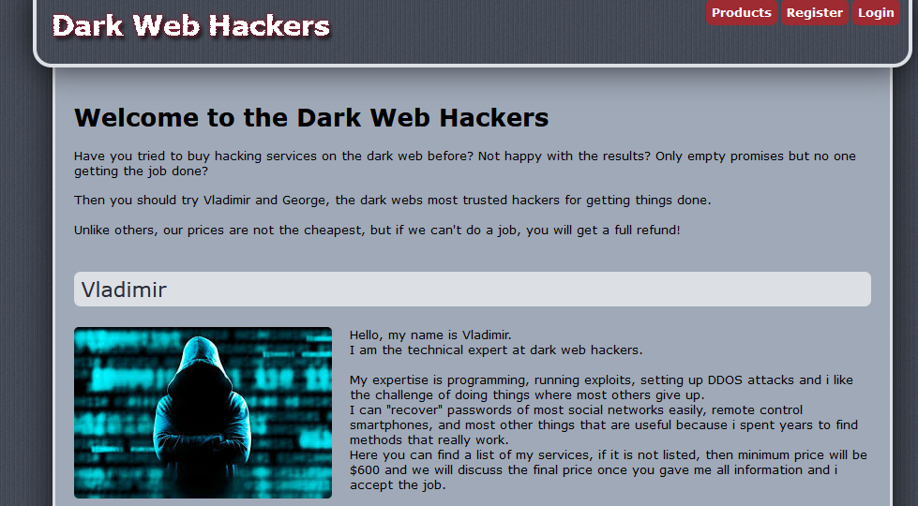

Slide 30
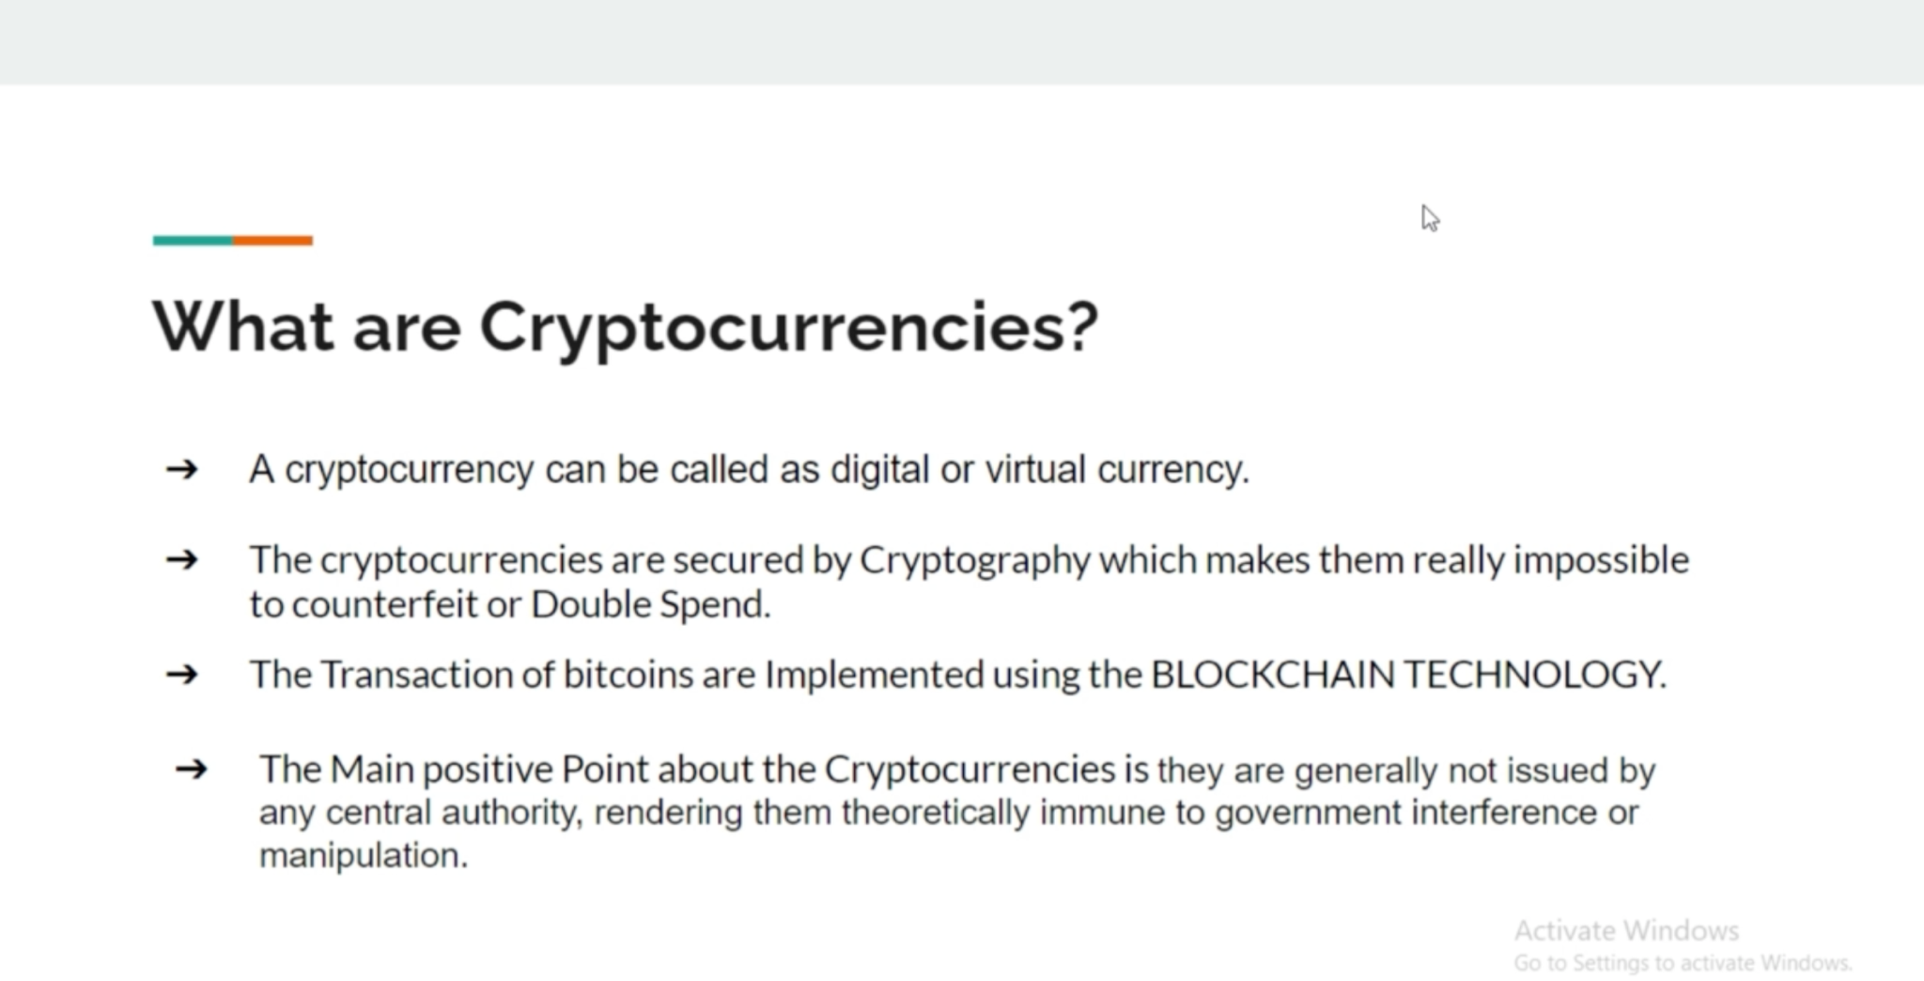

Slide 31
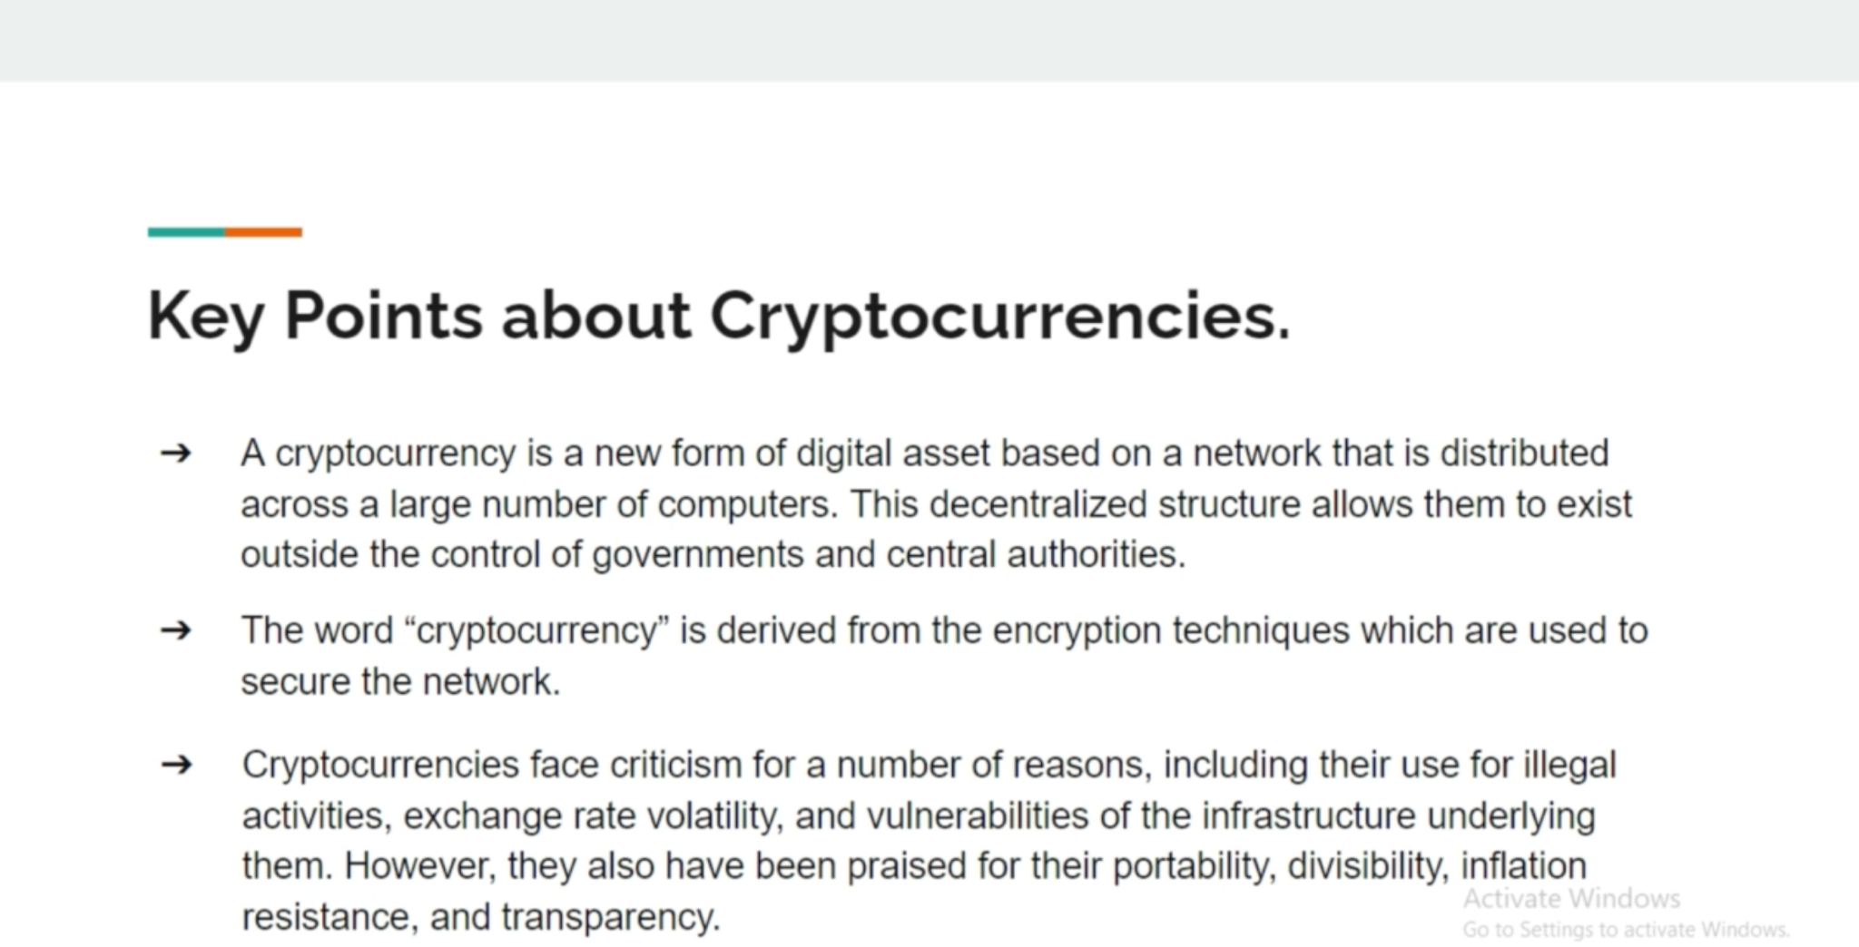

Slide 32
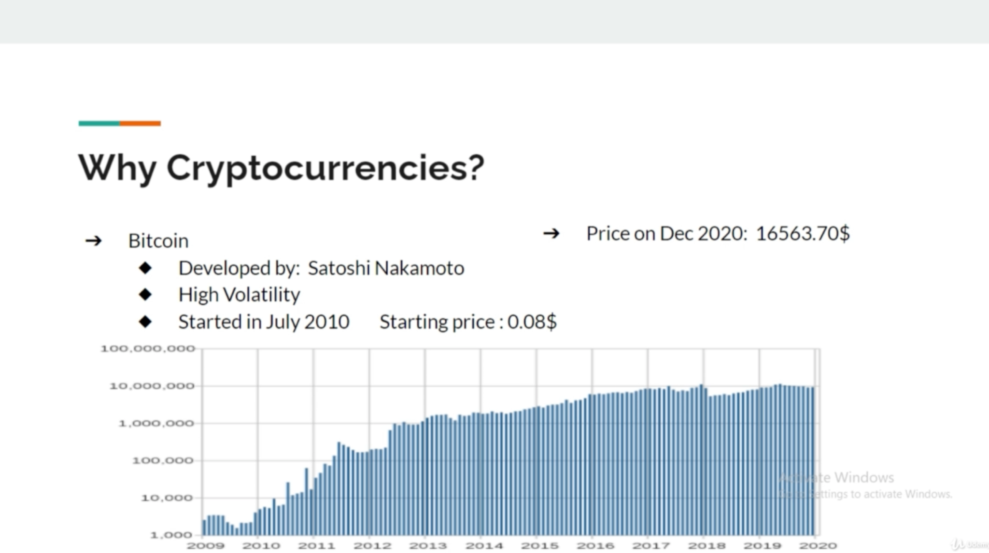

Slide 33
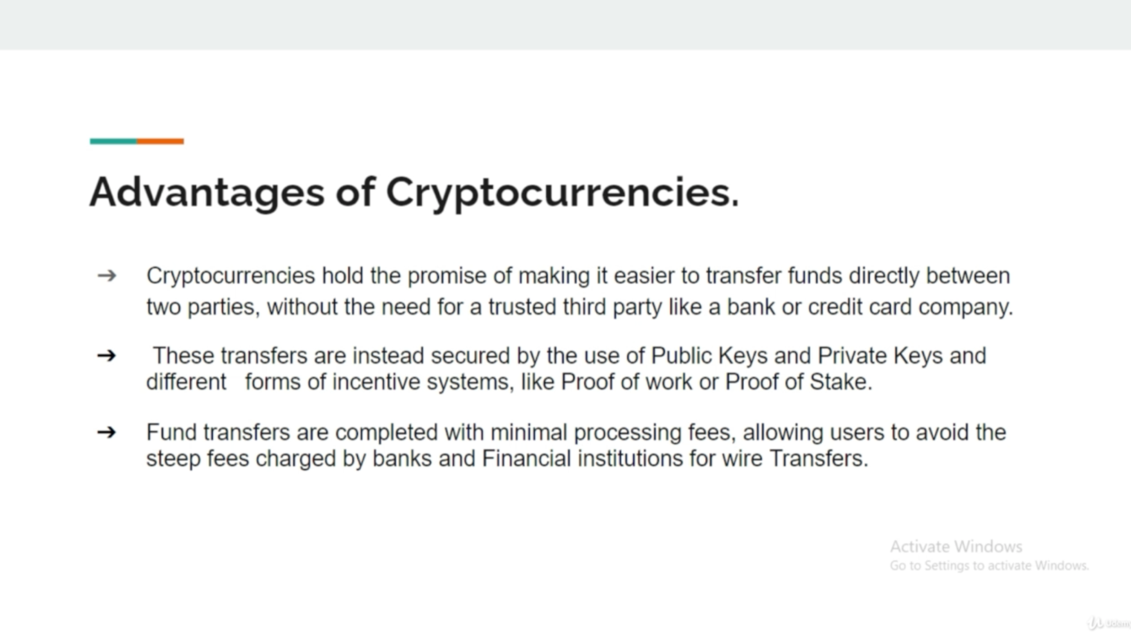

Slide 34
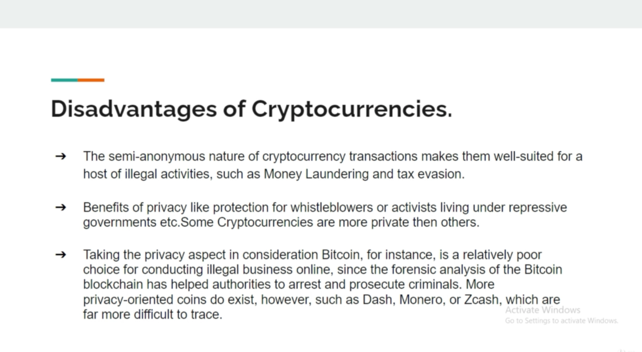

Slide 35
How to get, buy and sell bitcoins ?
1. https://www.coinbase.com/
2. https://www.blockchain.com/
3. https://binance.com

Slide 36
Cryptocurrencies
Bitcoin (BTC)
Litecoin (LTC)
Ethereum (ETH)
Zcash (ZEC)
See list of cryptocurrencies: https://www.coinbase.com/earn

Slide 37
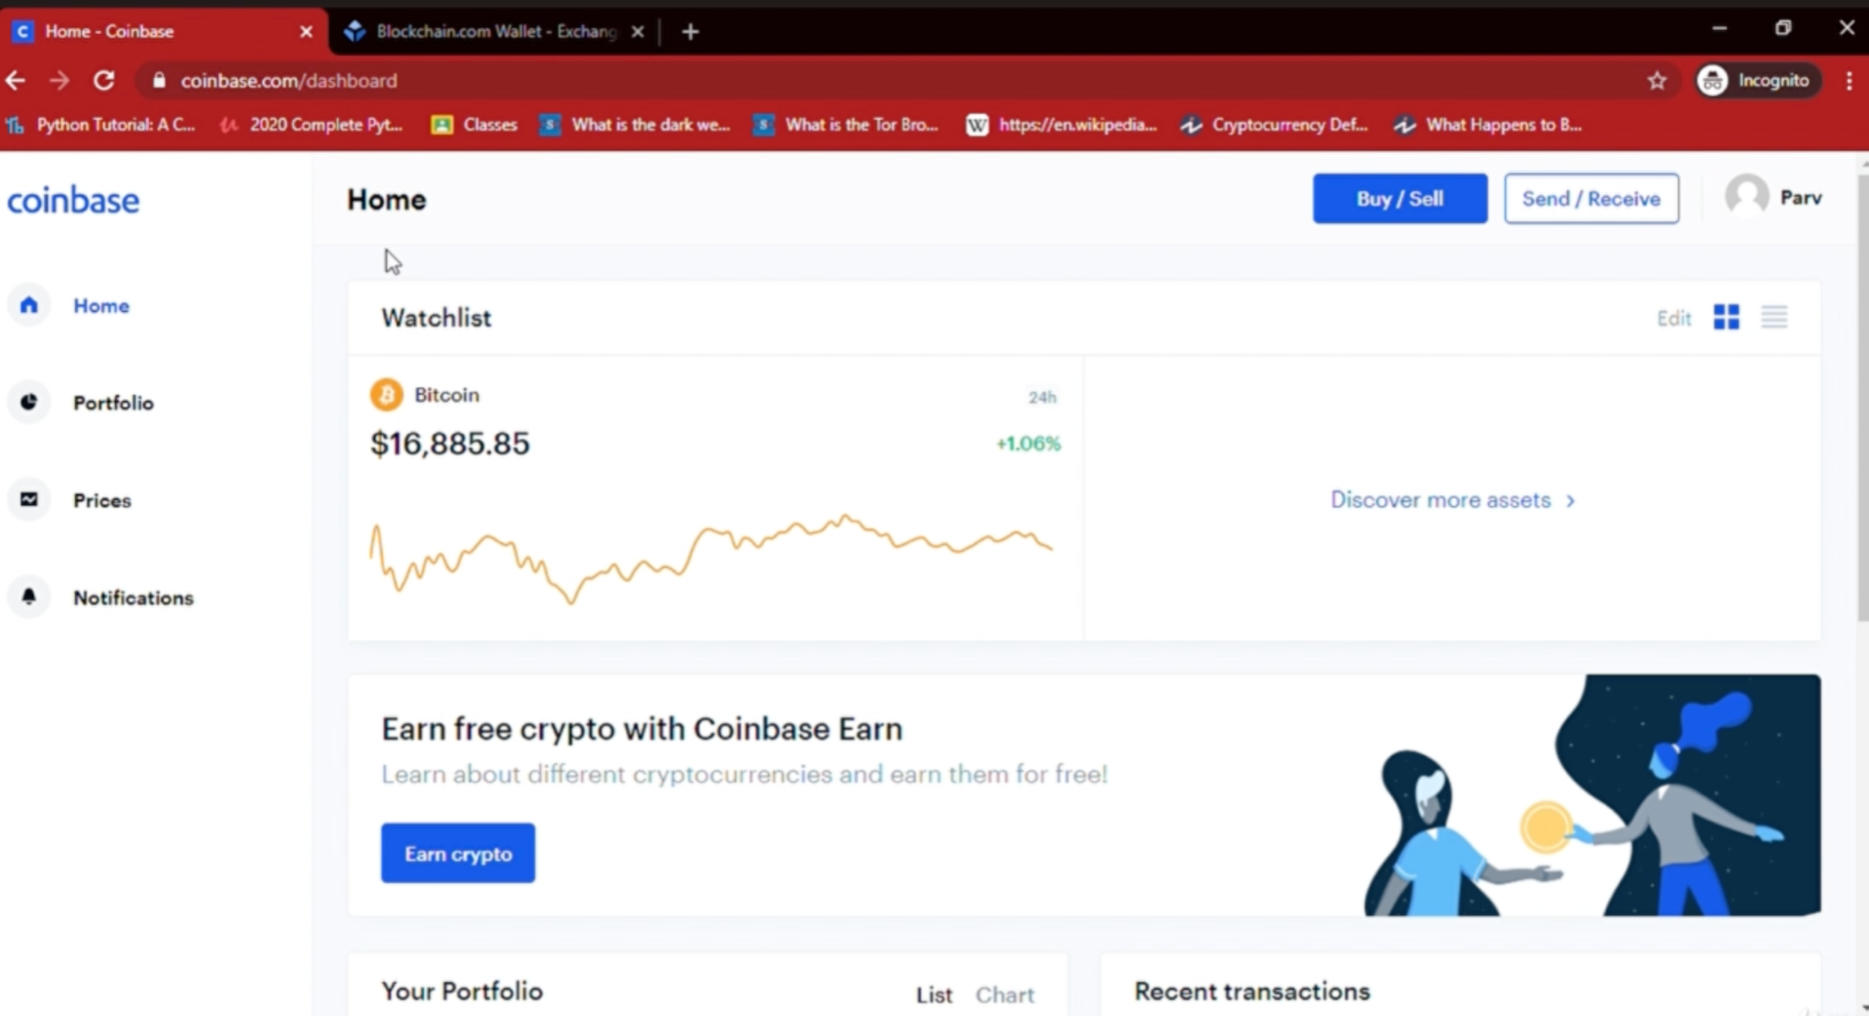

Slide 38
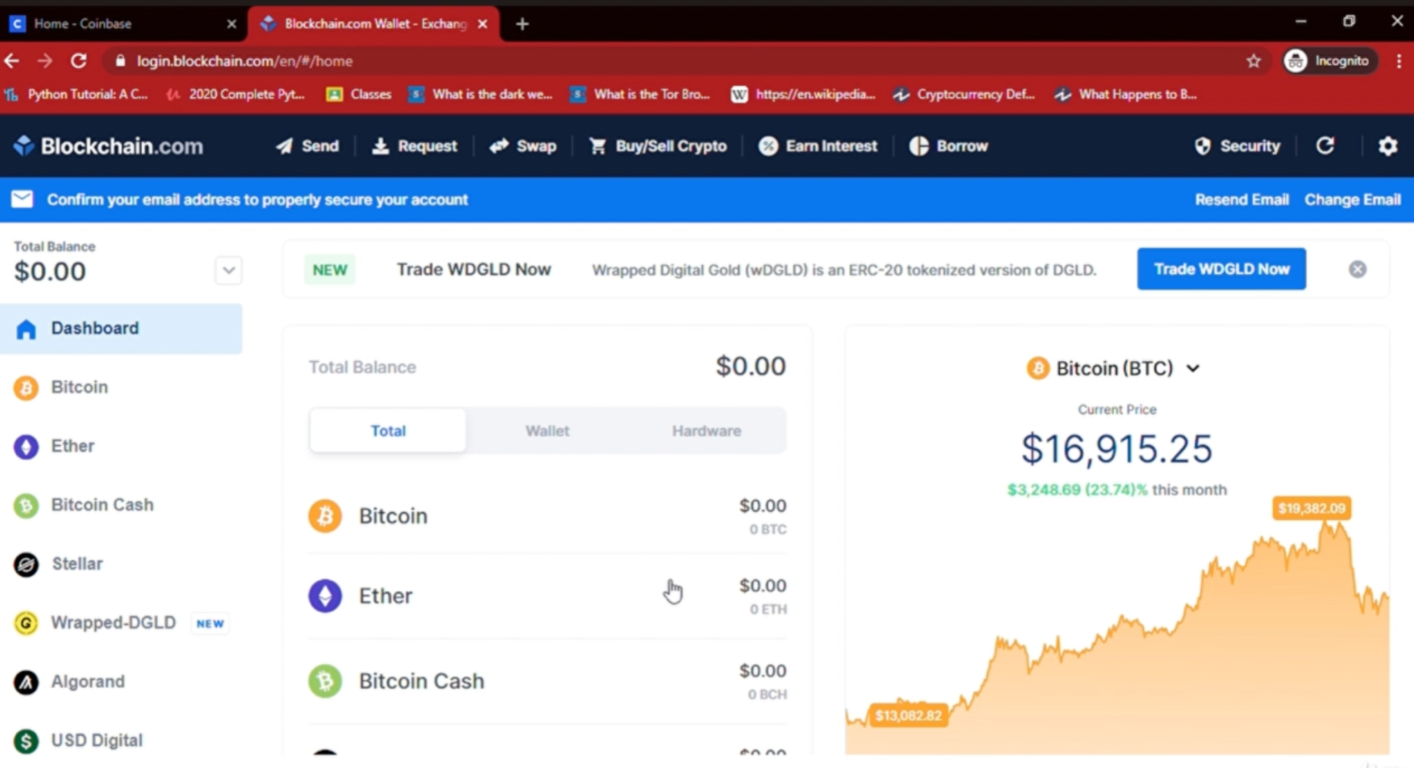

Slide 39
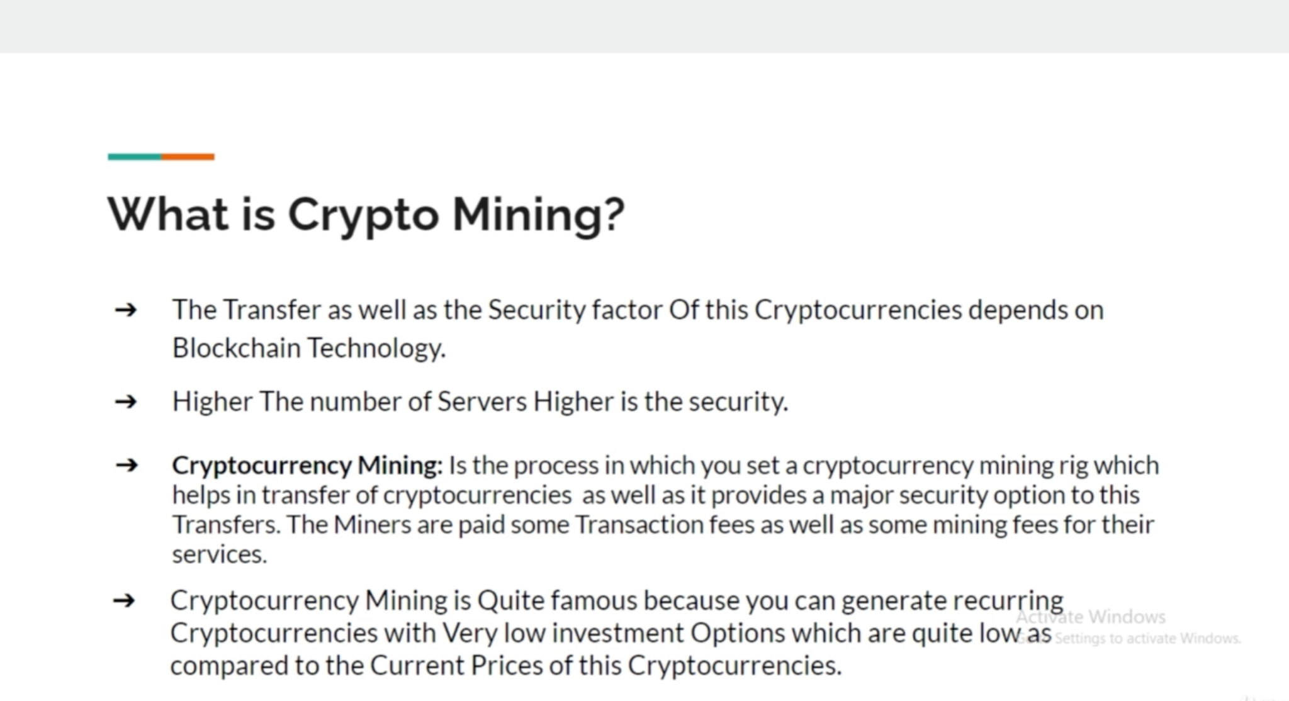

Slide 40
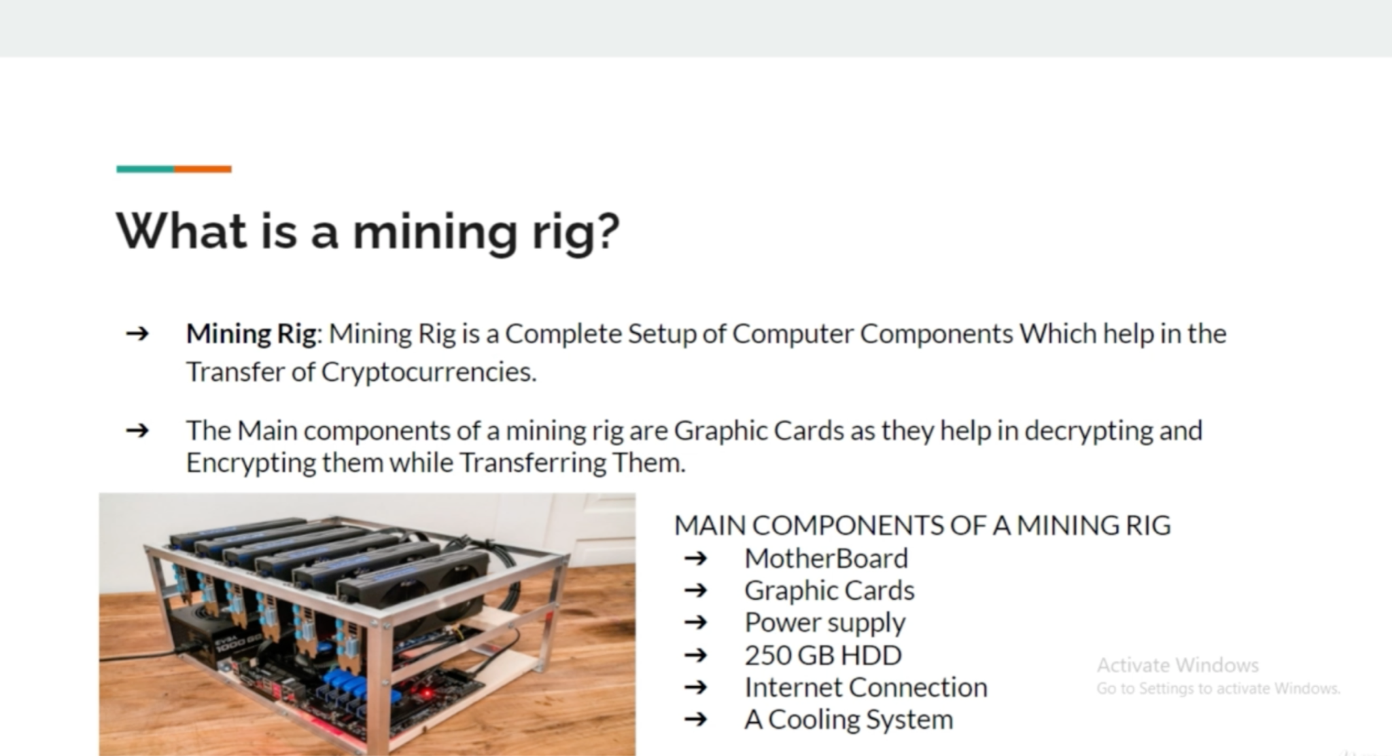

Slide 41
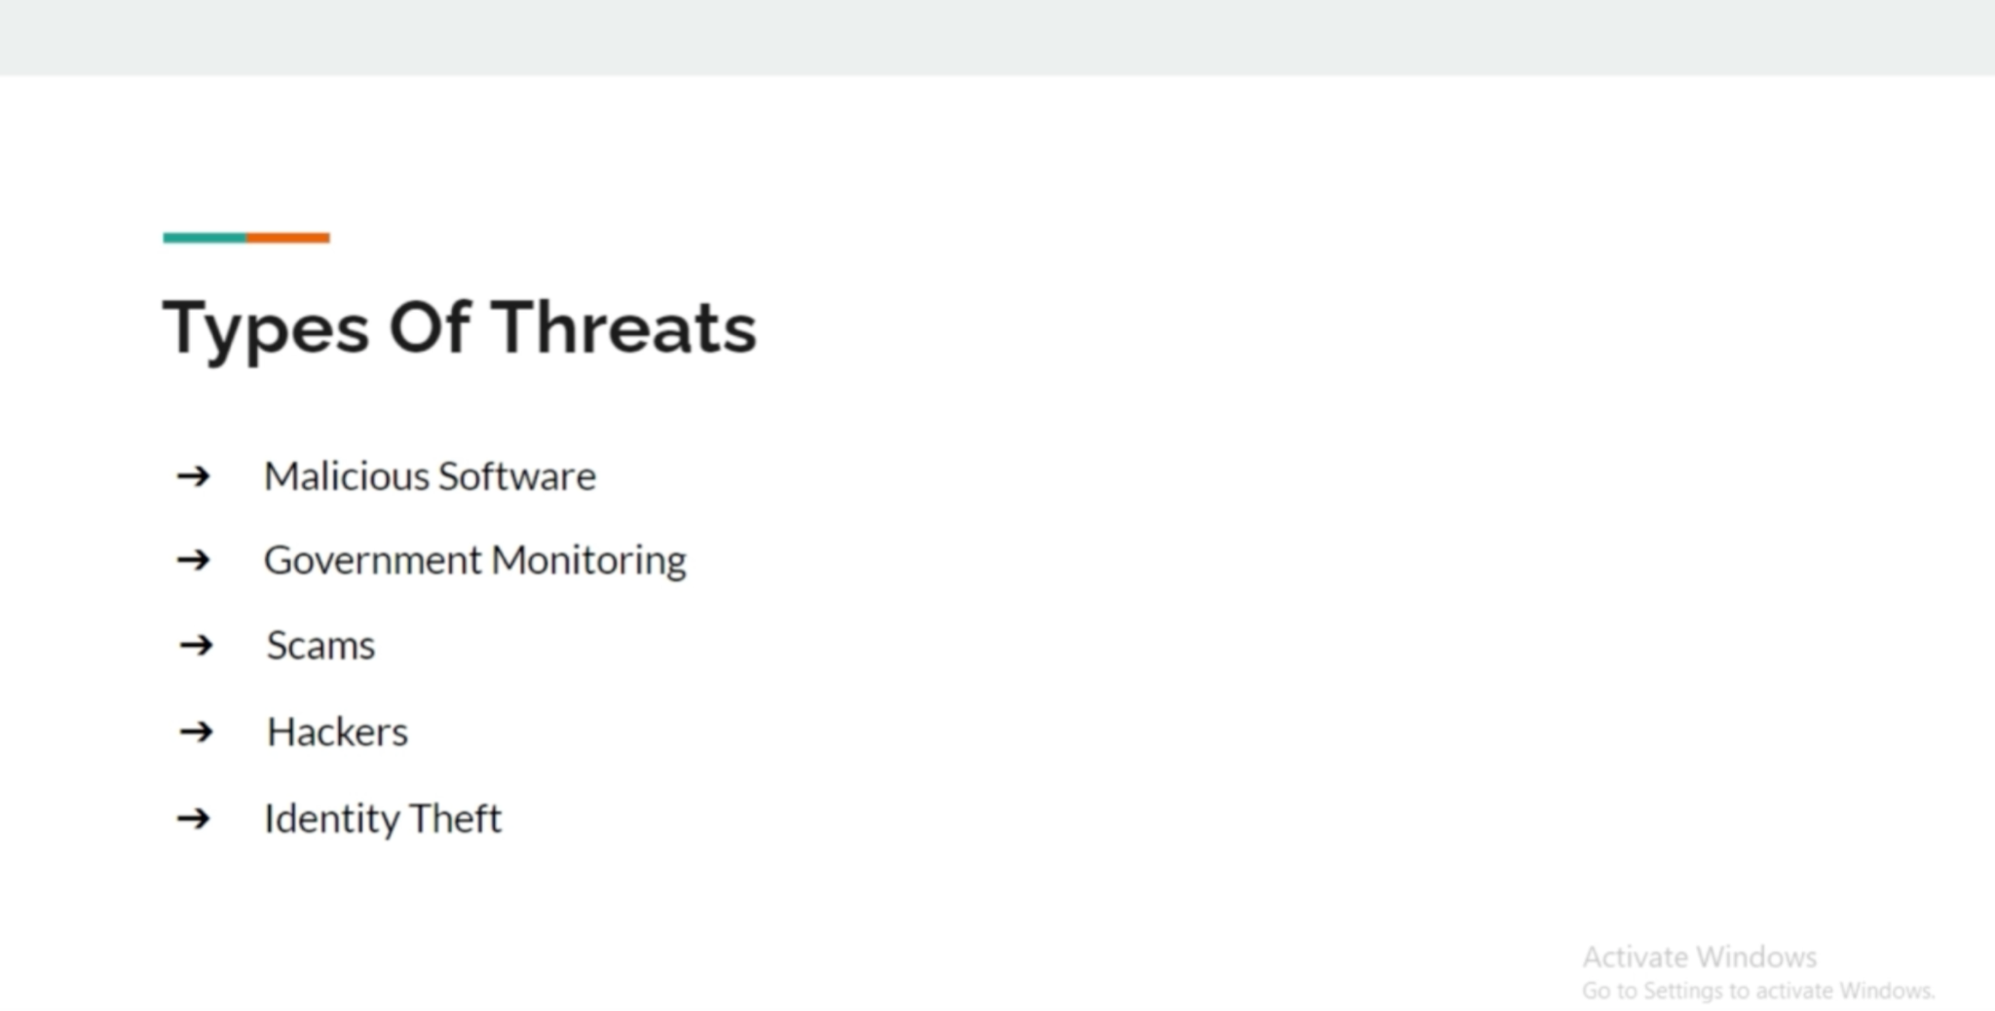

Slide 42
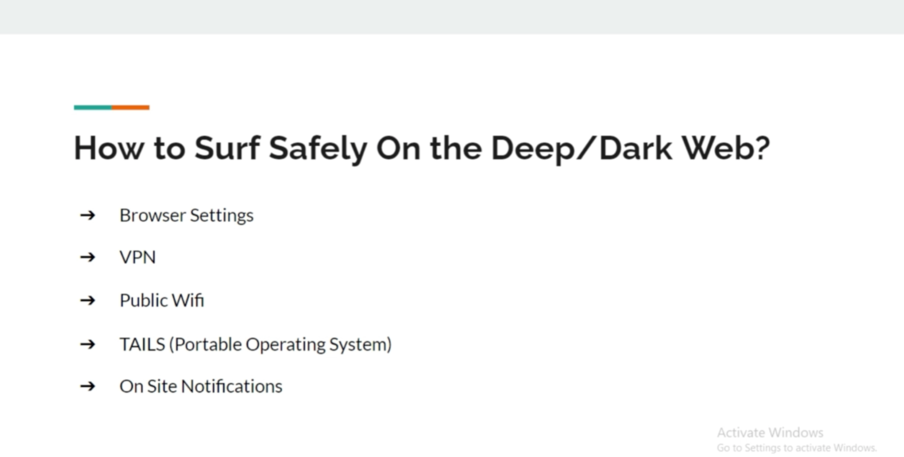

Slide 43
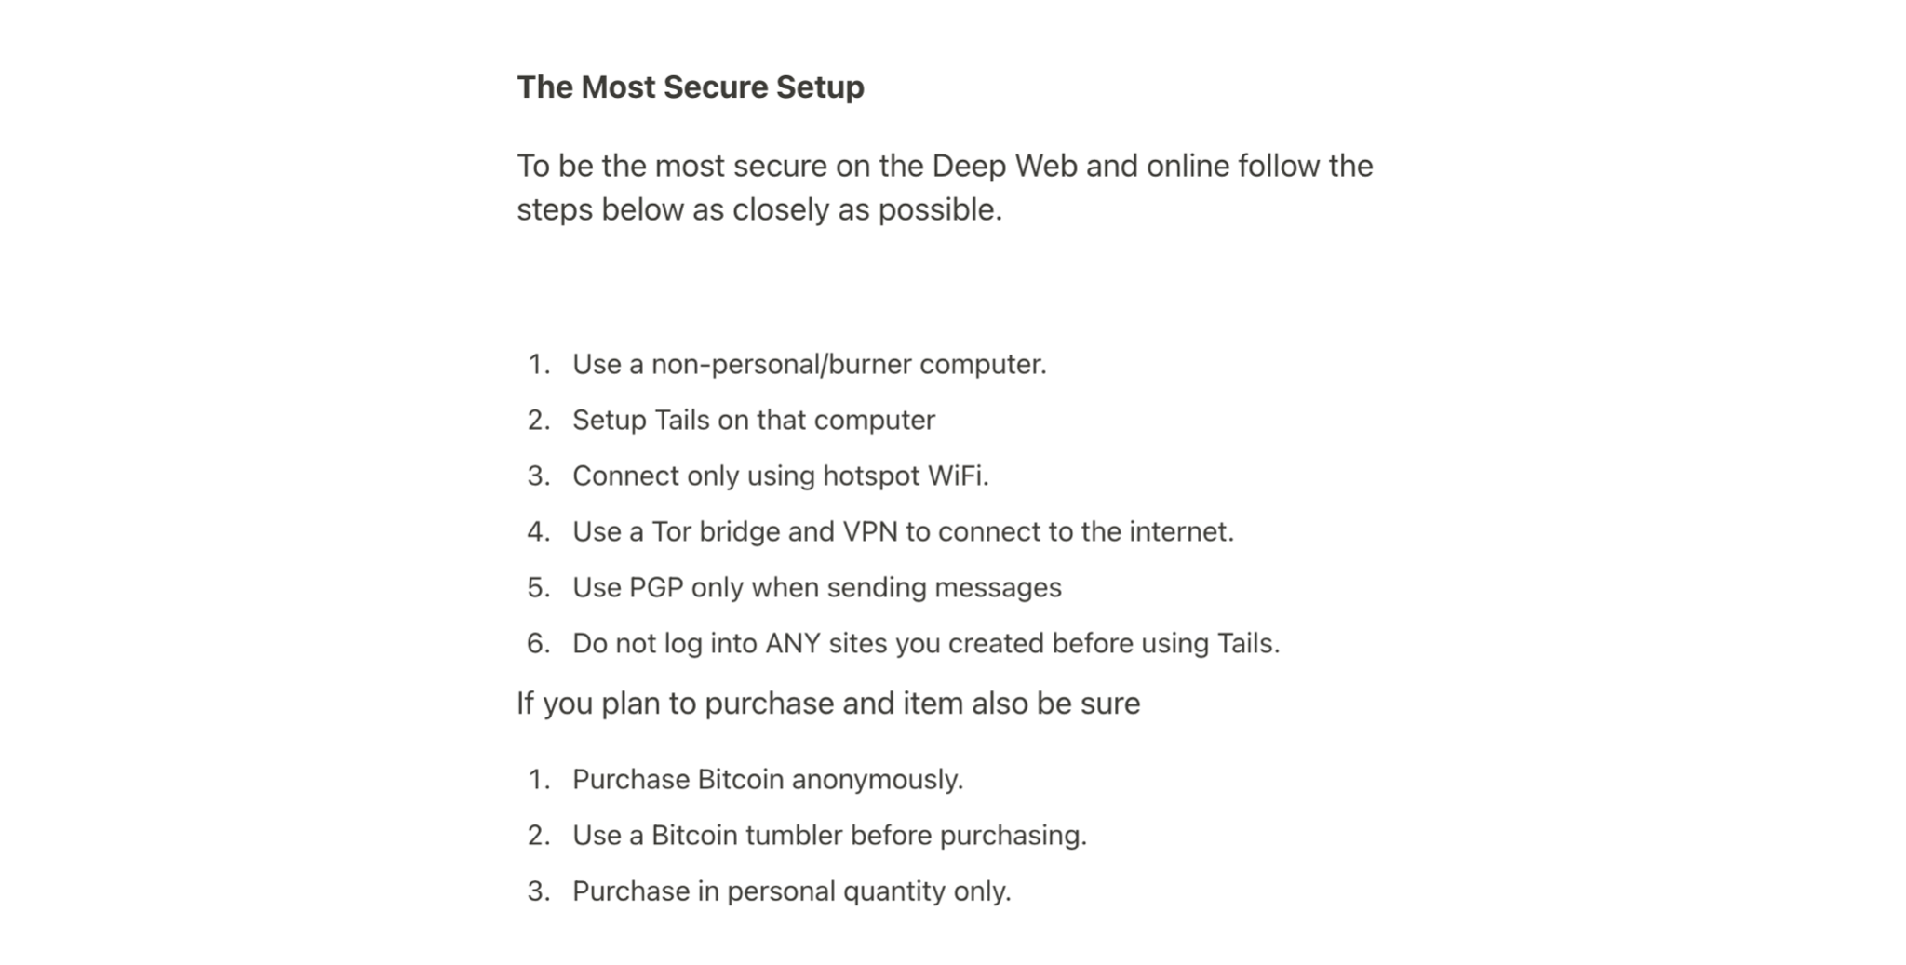

Slide 44
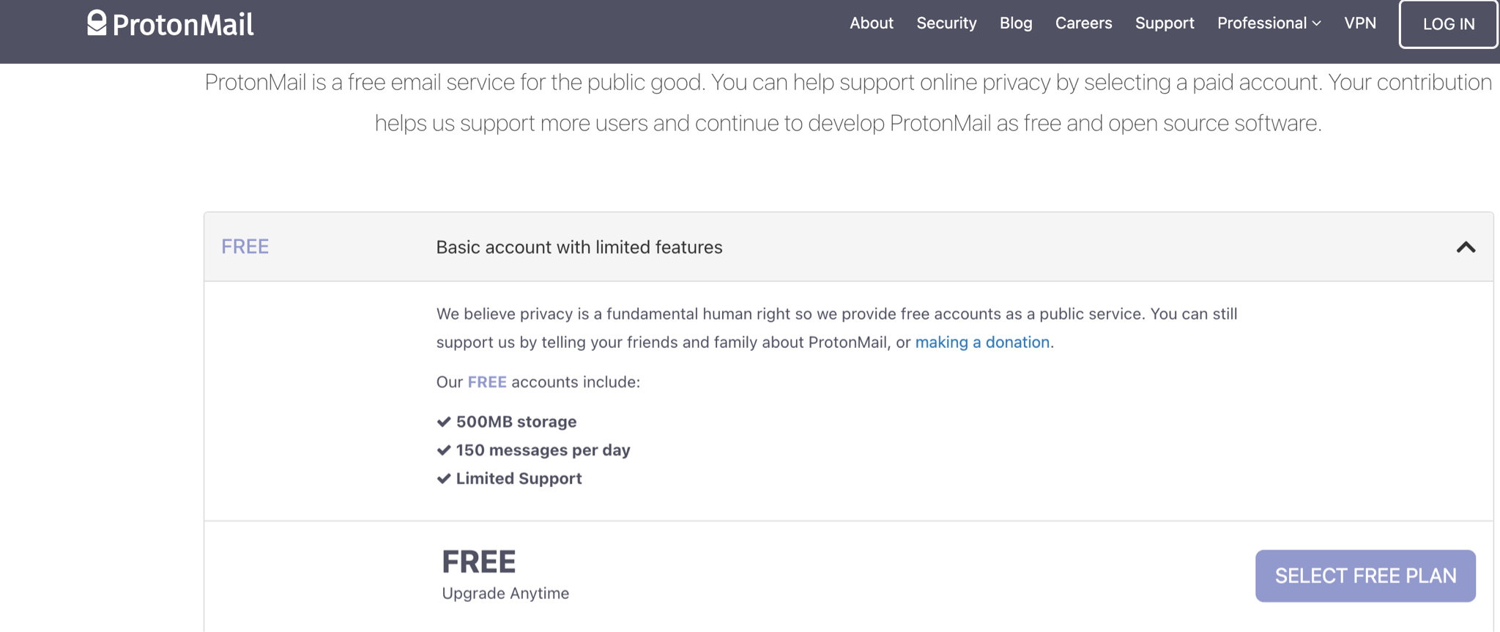

Slide 45
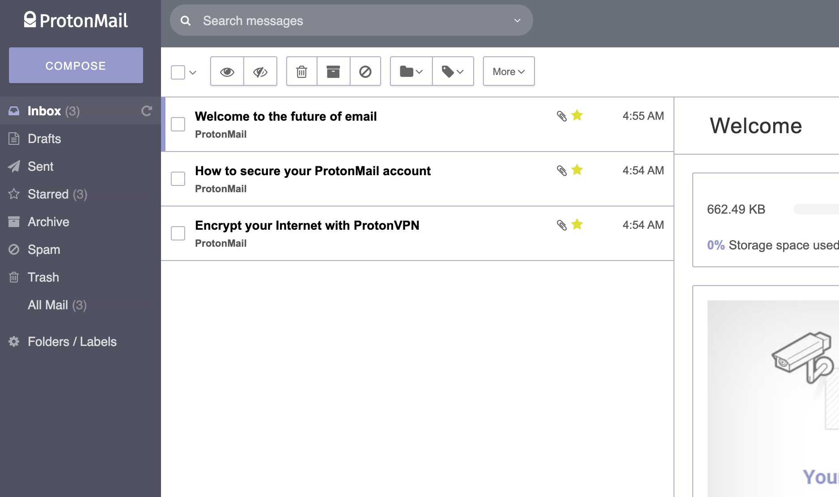

Slide 46


Slide 47
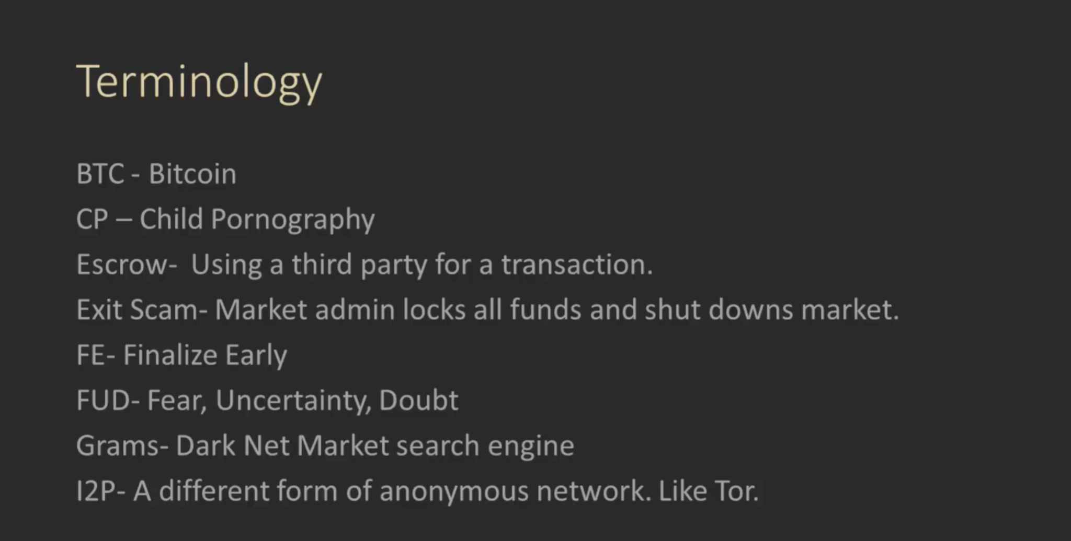

Slide 48


